Slide 1
Alternative Blood Collection Device (ABCD)
Ori Shemla
April 2025

Slide 2
Outline
1
Pearson correlation
2
Spearman correlation
3
Linear regression
4
Normalization considerations due to slope and intercept
5
Key highlights

Slide 3
ABCD Experiment Protocol
BioIVT will collect blood samples from 25 healthy donors over three separate days, with 8–10 donors per session.
Blood samples from each healthy donor will be collected as outlined in Appendix A: On-site Blood Collection and Plasma Preparation Protocol, and Table 1 above, following the list below:
1 x EDTA tube
3 x Cell-Free DNA BCT tubes
3 x Protein Plus BCT tubes
1 x BD Vacutainer™ Mononuclear CPT tube
Protocol # | Tube type | Location of centrifugation and plasma isolation | Shipment temperature | Time from collection to centrifugation
1* | EDTA | Point of collection | -80⁰C | Up to 4 hours
2 | VAMS | Point of collection | RT | Up to 4 hours
3 | CPT | Point of collection | -80⁰C | Up to 4 hours
4 | Streck cfDNA | OncoHost lab | RT | 24 hours
5 | Streck Protein Plus | OncoHost lab | RT | 24 hours
6 | Streck cfDNA | OncoHost lab | RT | 72 hours
7 | Streck Protein Plus | OncoHost lab | RT | 72 hours
8 | Streck cfDNA | OncoHost lab | RT | 120 hours
9 | Streck Protein Plus | OncoHost lab | RT | 120 hours

Slide 4
Cohorts – phase 1
Baseline method | Tested methods | Time to centrifuge | Number of subjects | Number of samples | Site | Details
EDTA Plasma (20) | CPT Plasma (20) STRECK-PROT+ DS (20) STRECK-cfDNA DS (20) STRECK-PROT+ (20) | 68-76 hours | 20 | 100 | BioIVT | healthy subjects aged 18+
EDTA Plasma (55) | SST Serum (55) | Up to 4 hours | 55 | 110 | Heidelberg | Patients with mNSCLC, Pre-treatment (PROPHETIC NCT04056247)
EDTA Plasma (21) | EDTA Plasma (21) (consecutive runs) | Up to 4 hours | 21 | 42 | Israeli sites | Patients with mNSCLC, Pre-treatment (OH Analytical validity)

Slide 5
Pearson Correlation

Slide 6
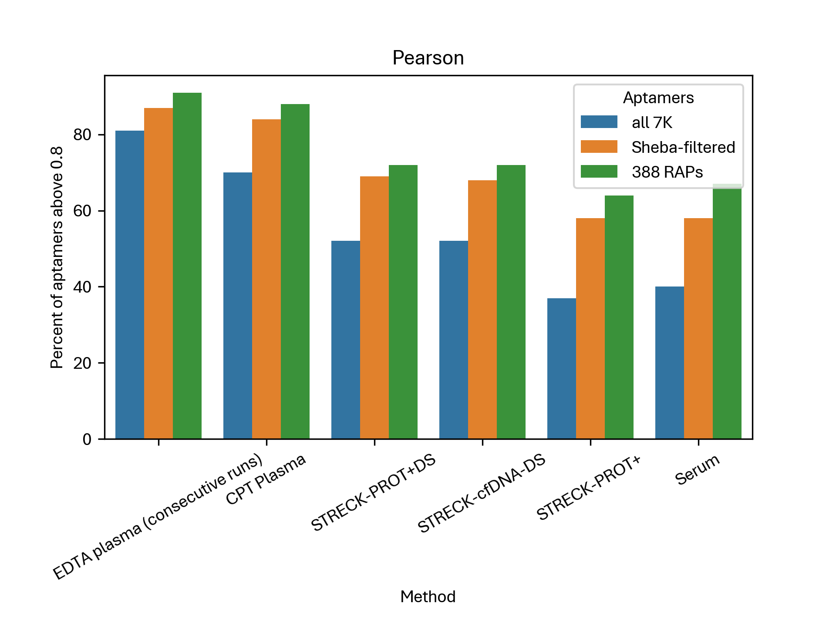
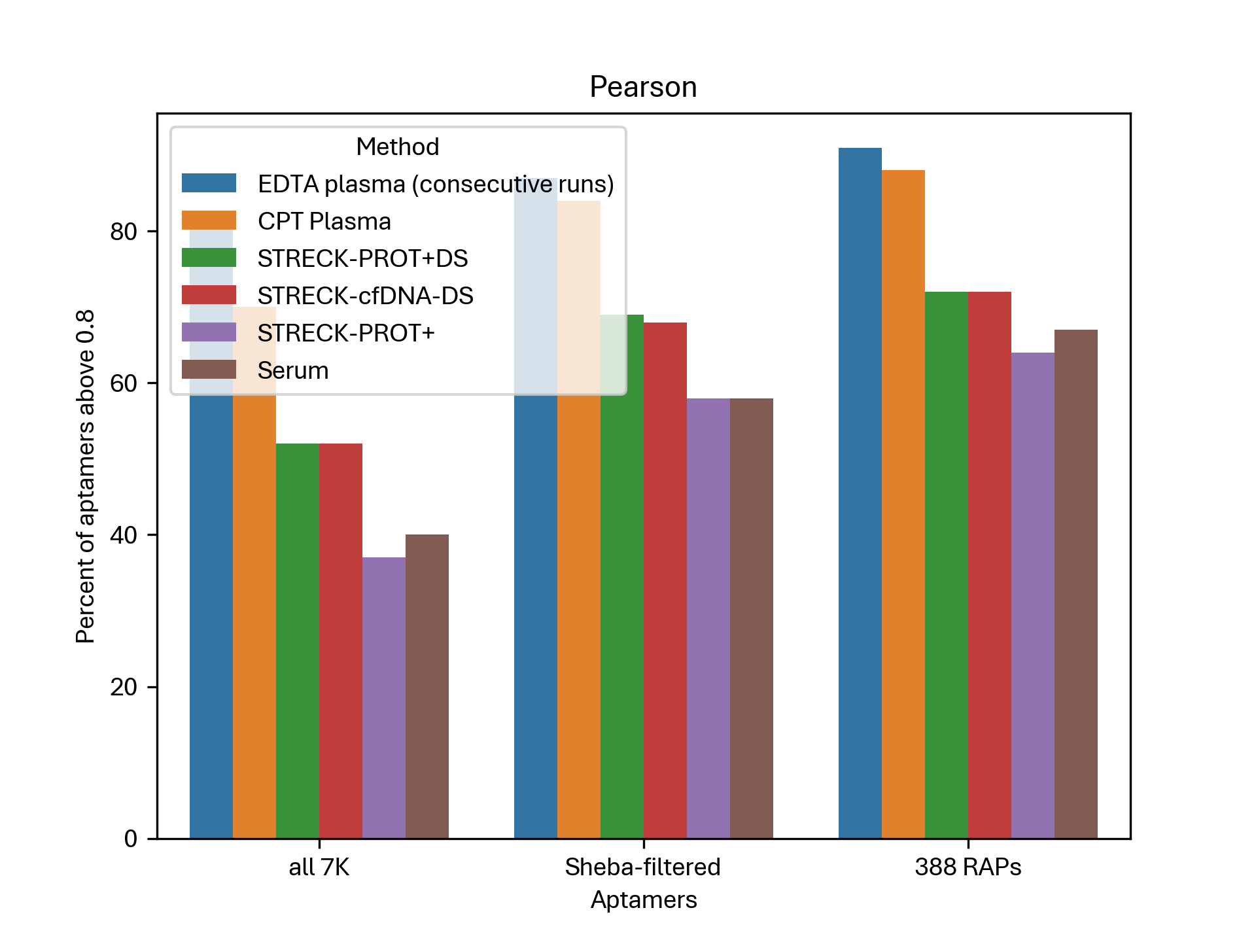
Pearson correlation – Summary

Slide 7
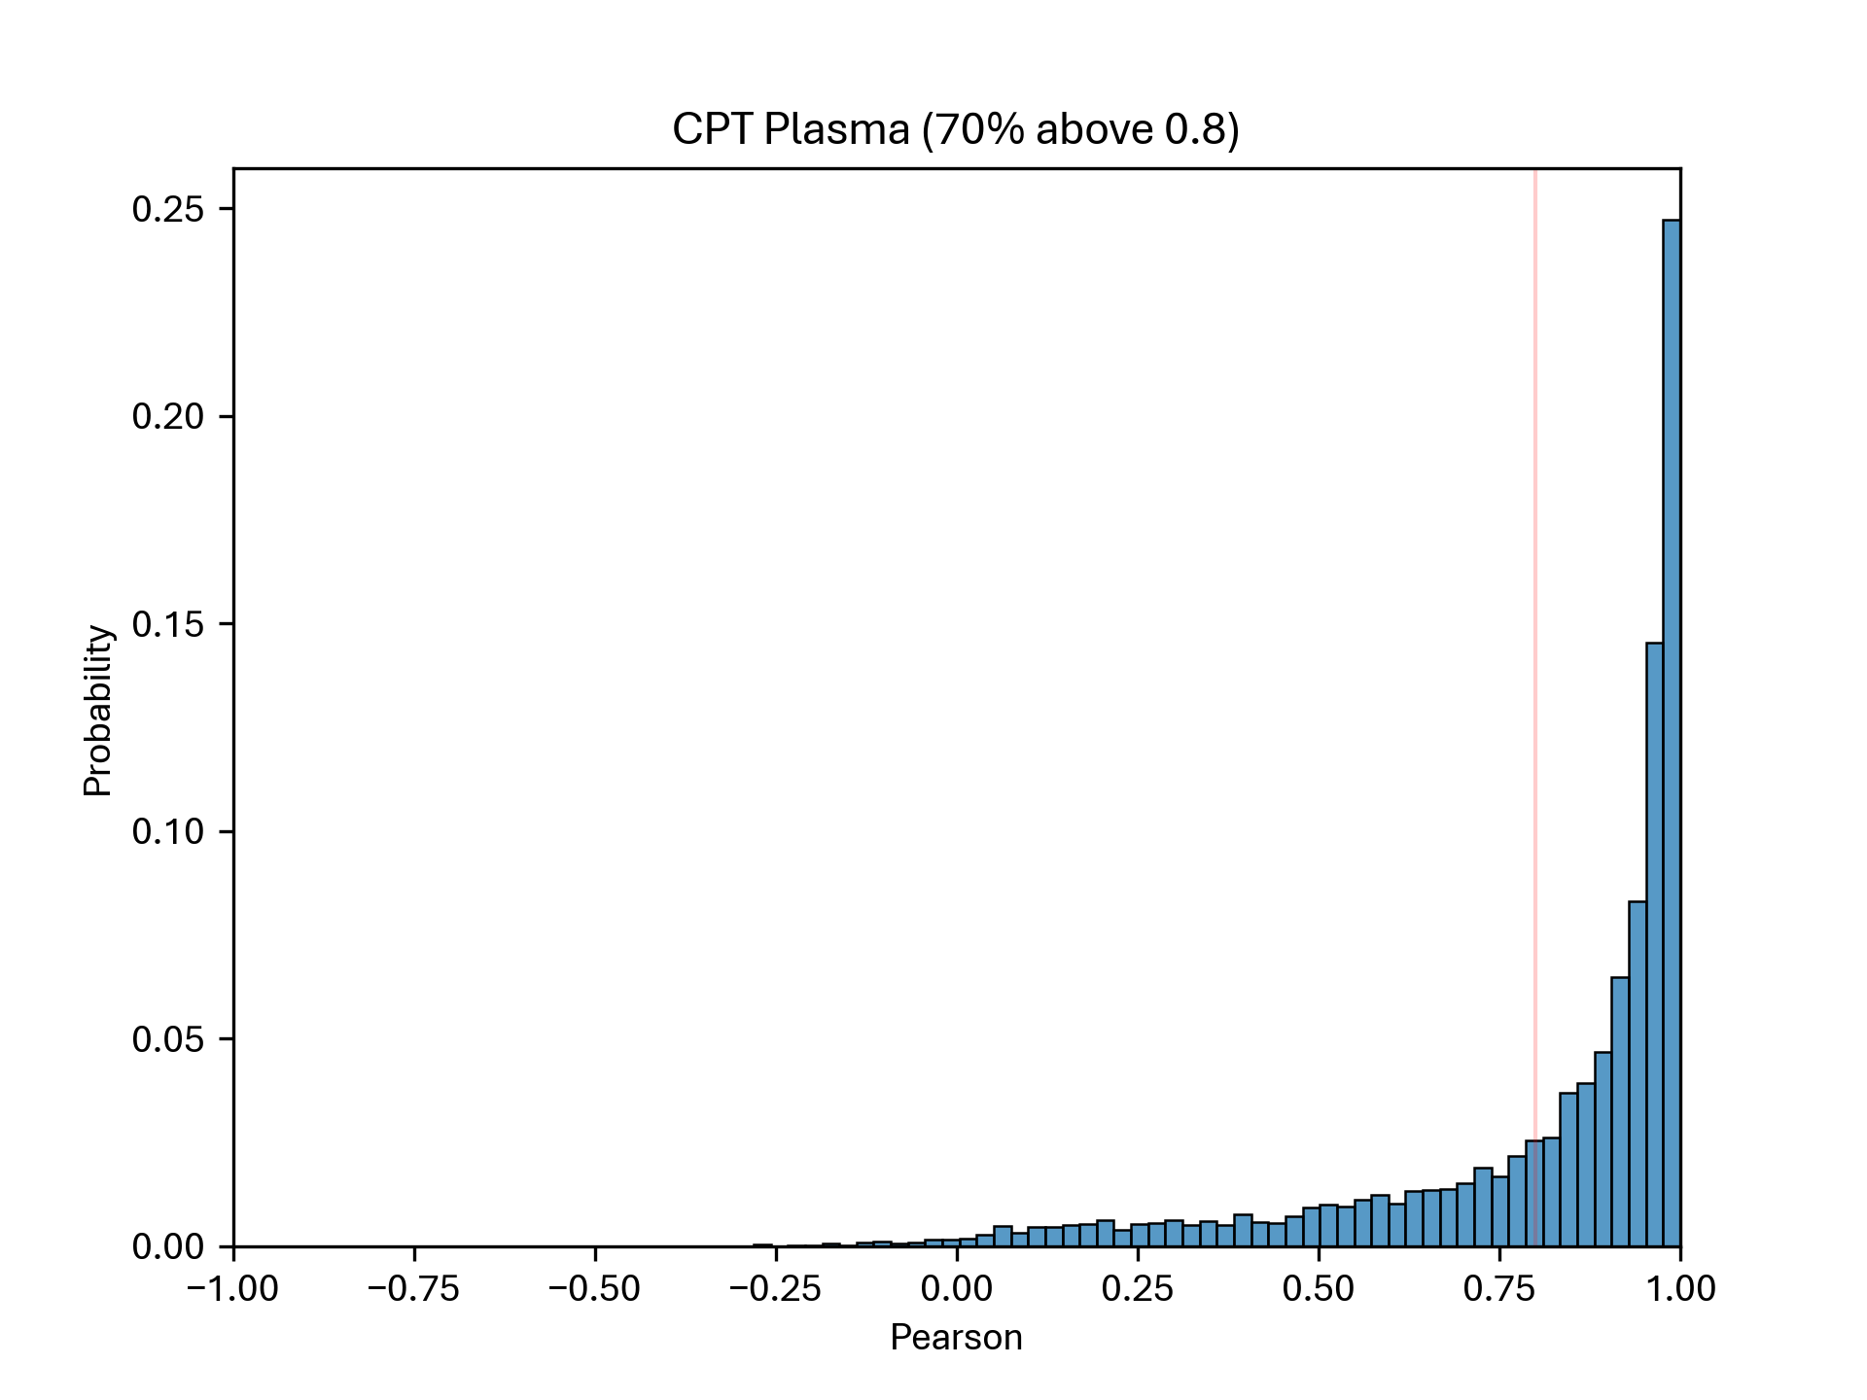
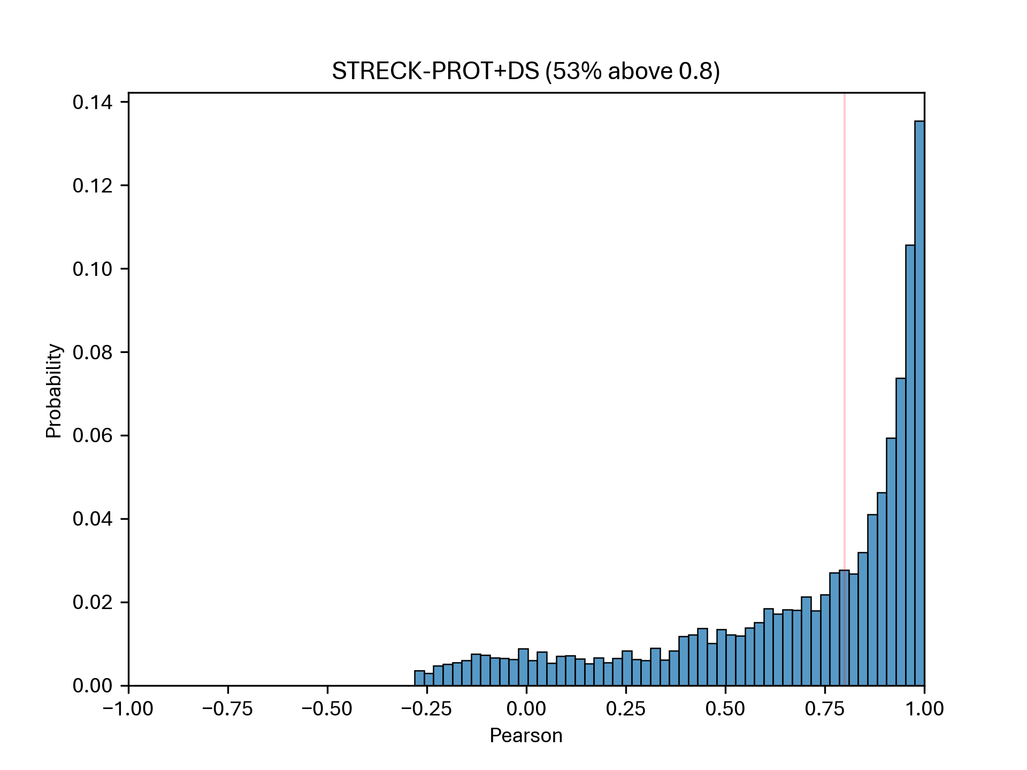
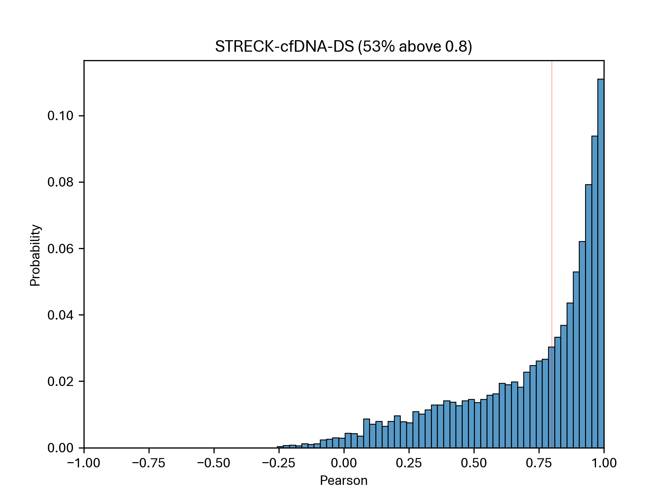
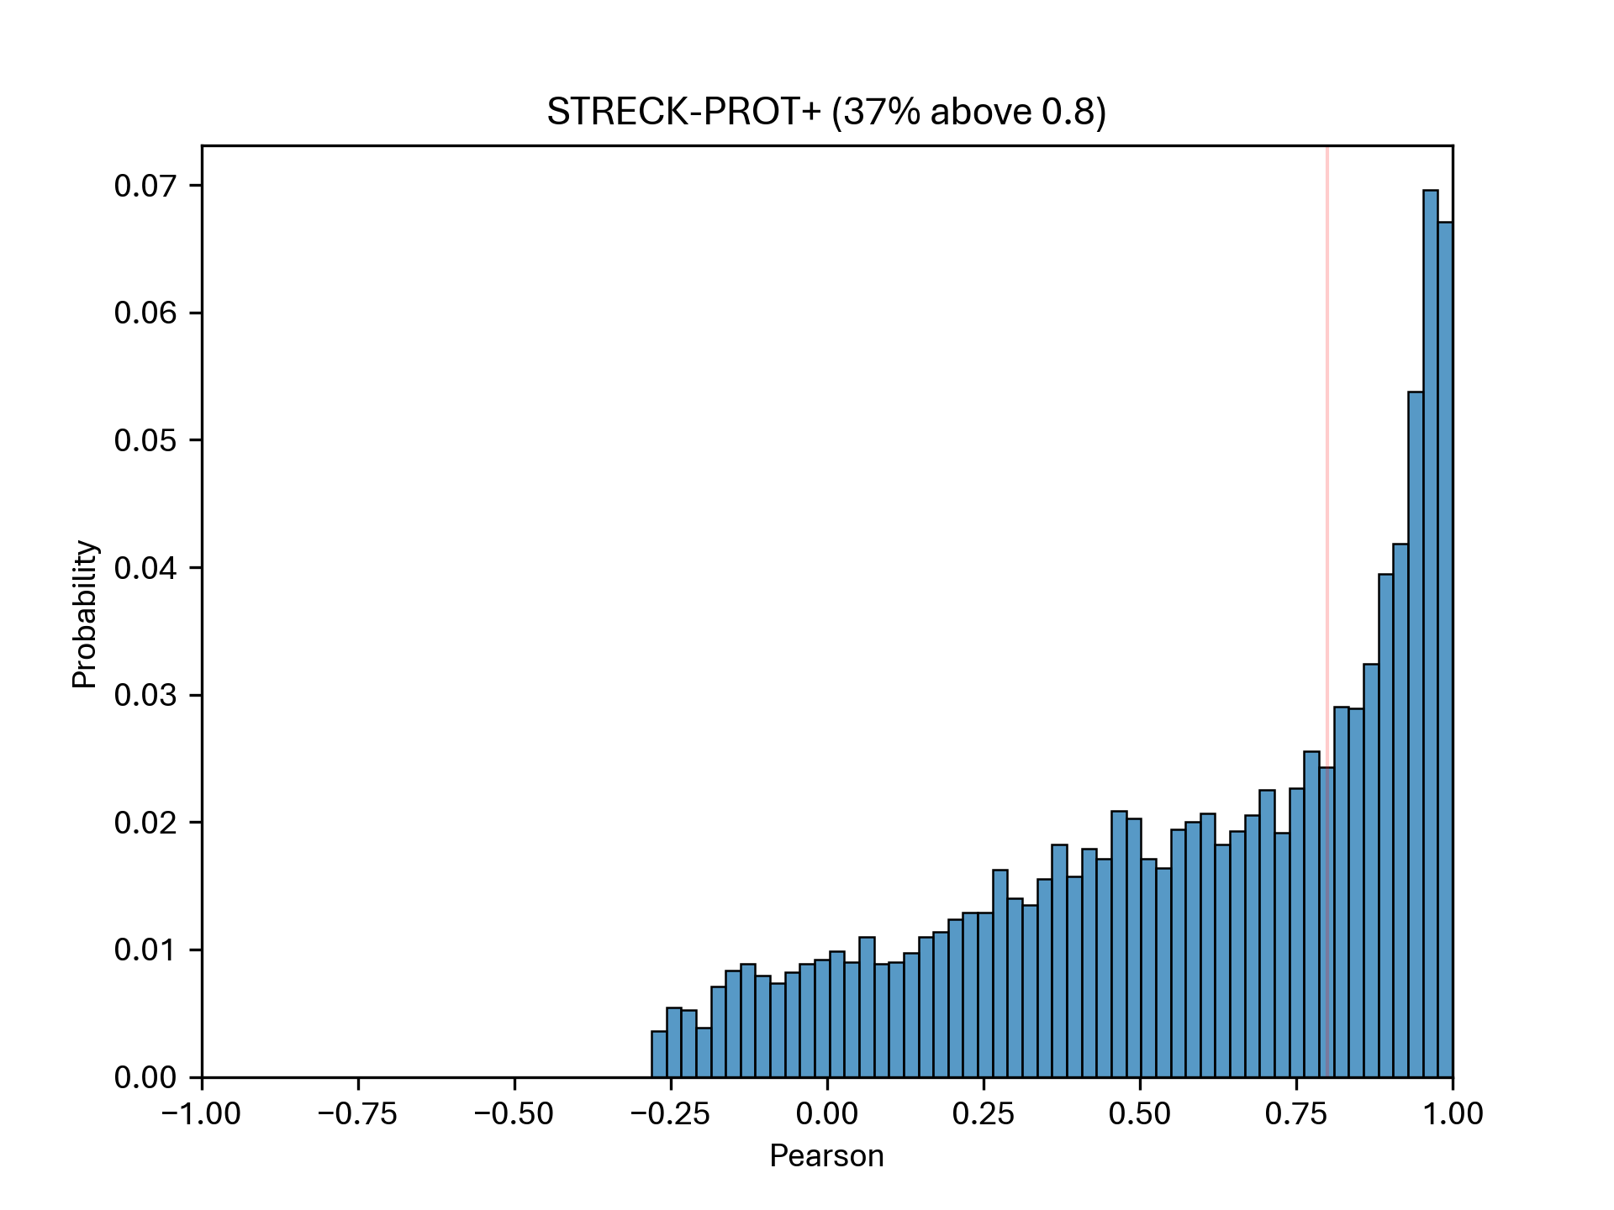
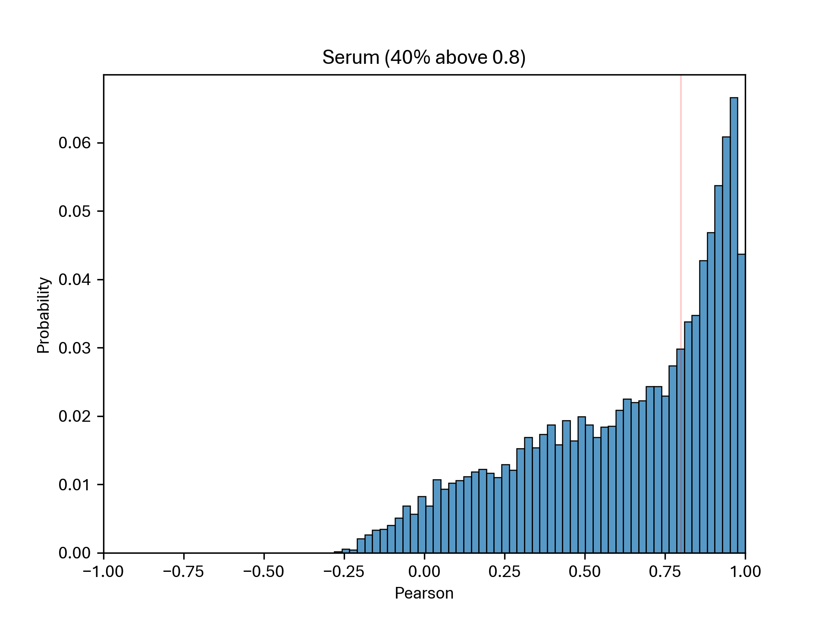
Pearson correlation – All 7K

Slide 8
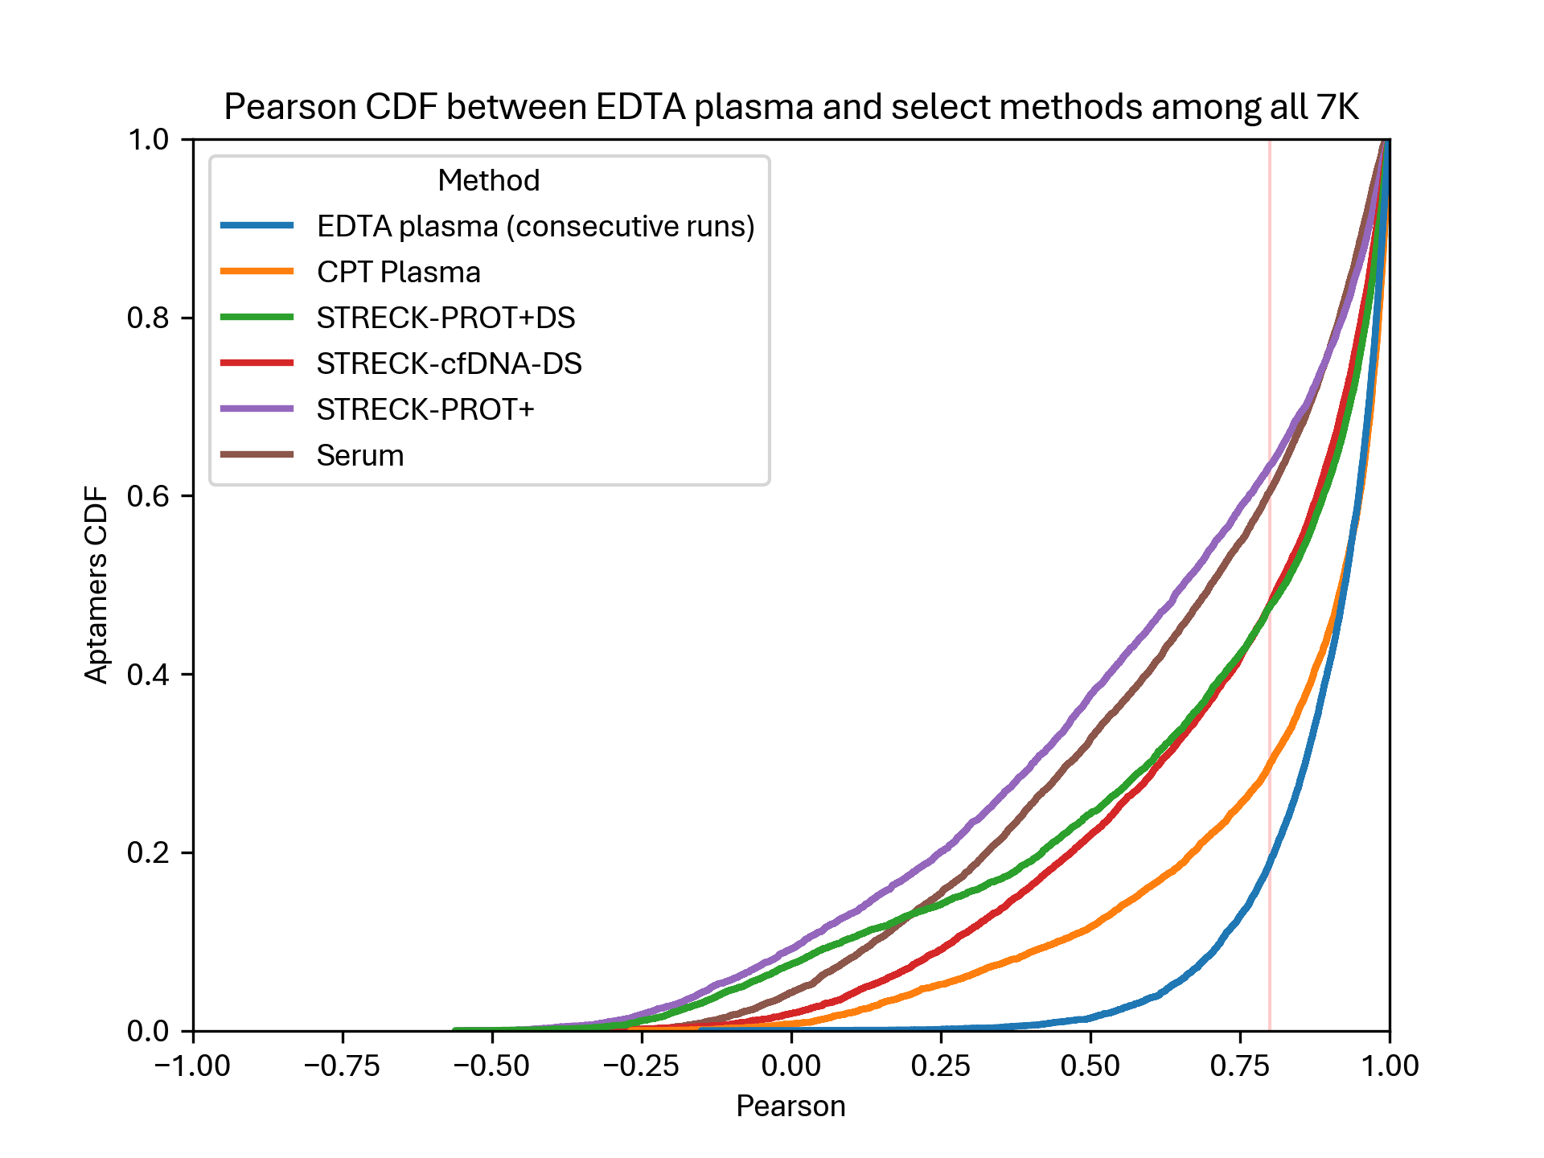
Pearson correlation – All 7K

Slide 9
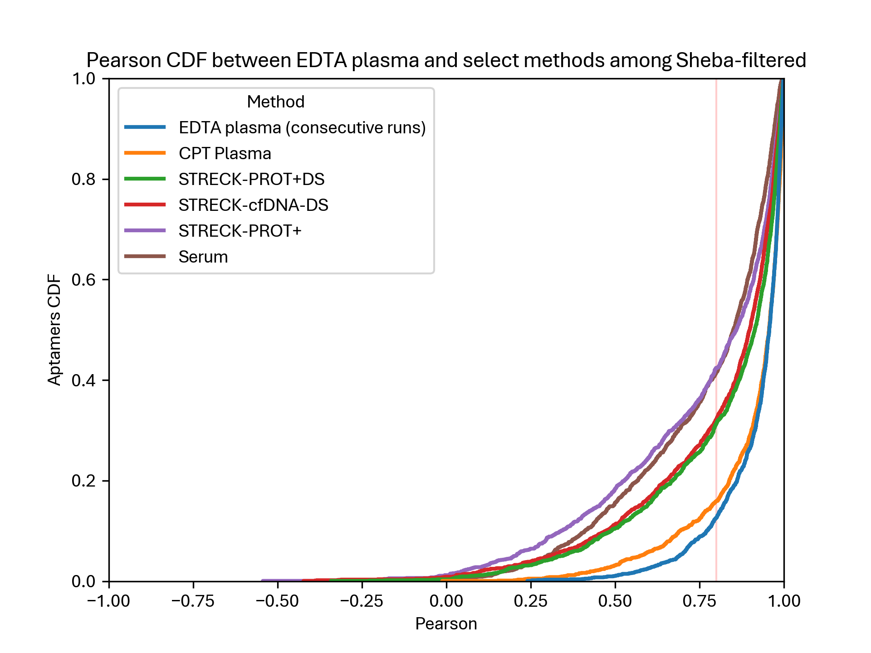
Pearson correlation – Sheba

Slide 10
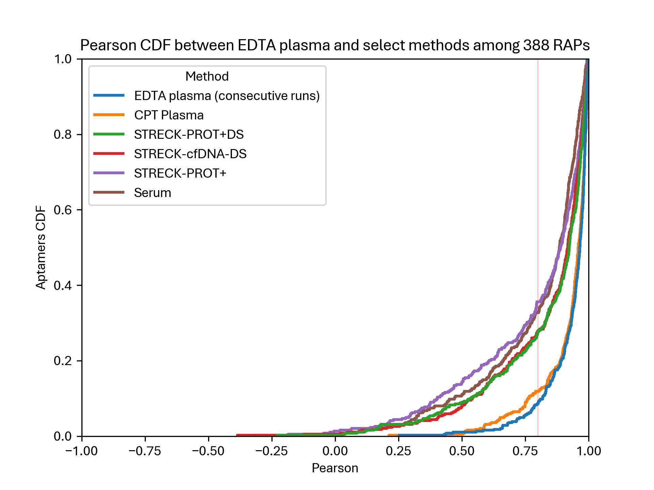
Pearson correlation – RAPs

Slide 11
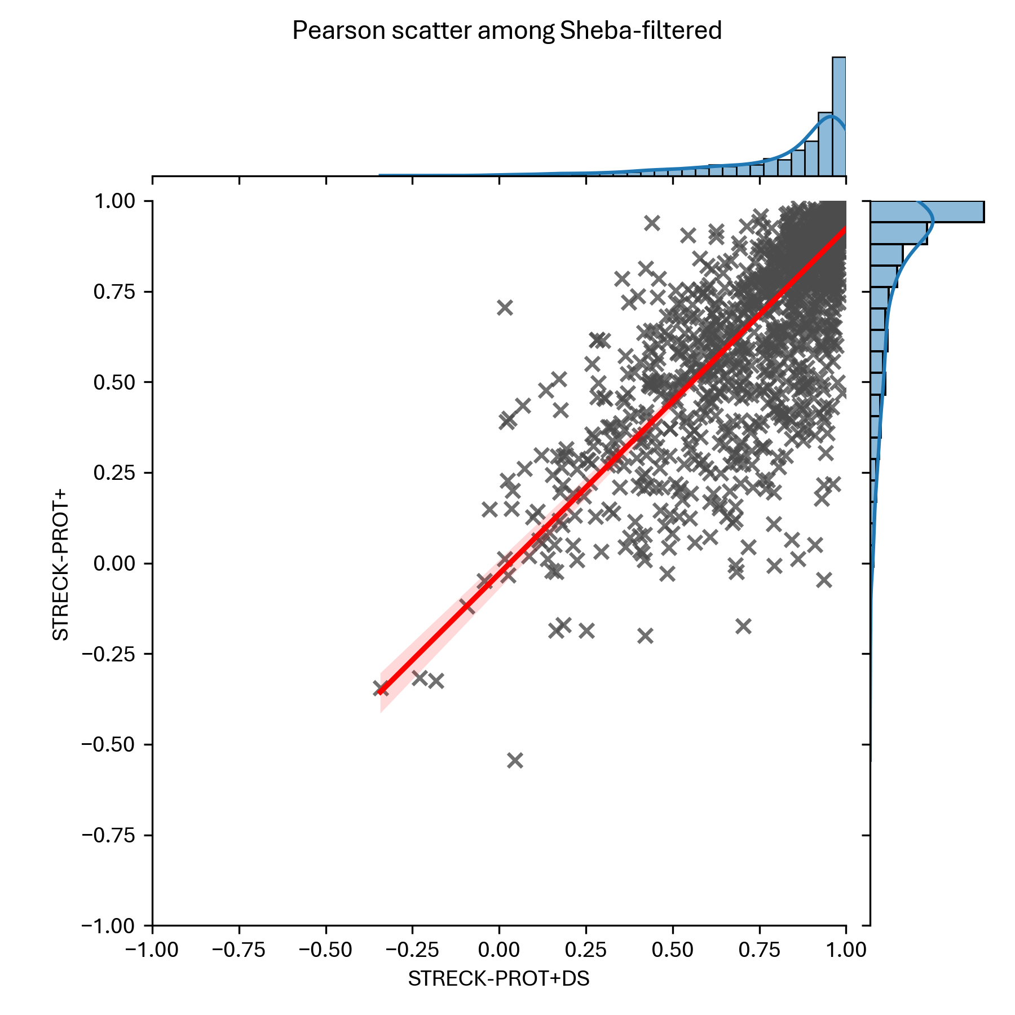
Pearson correlation – With/Without DS

Slide 12
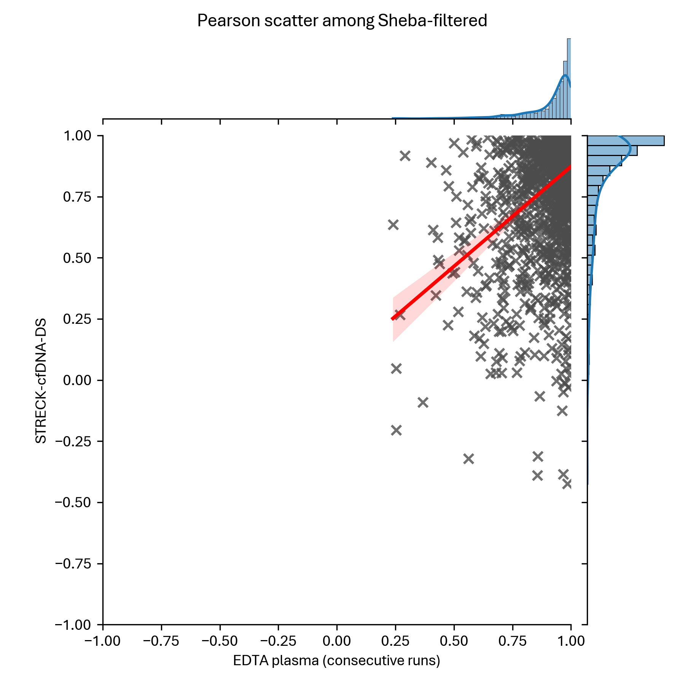
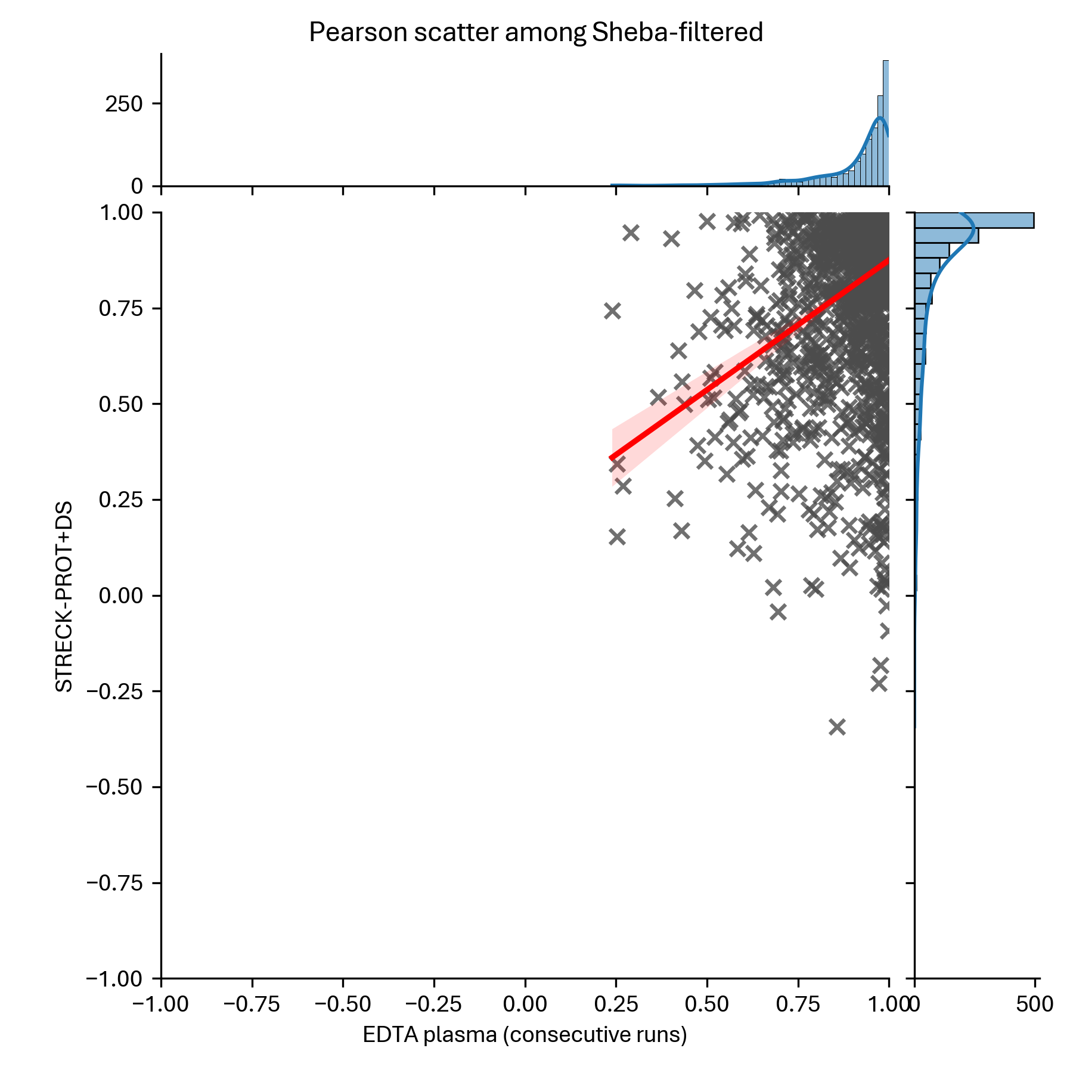
Pearson correlation – Streck Prot+ or cfDNA

Slide 13
Spearman Correlation

Slide 14
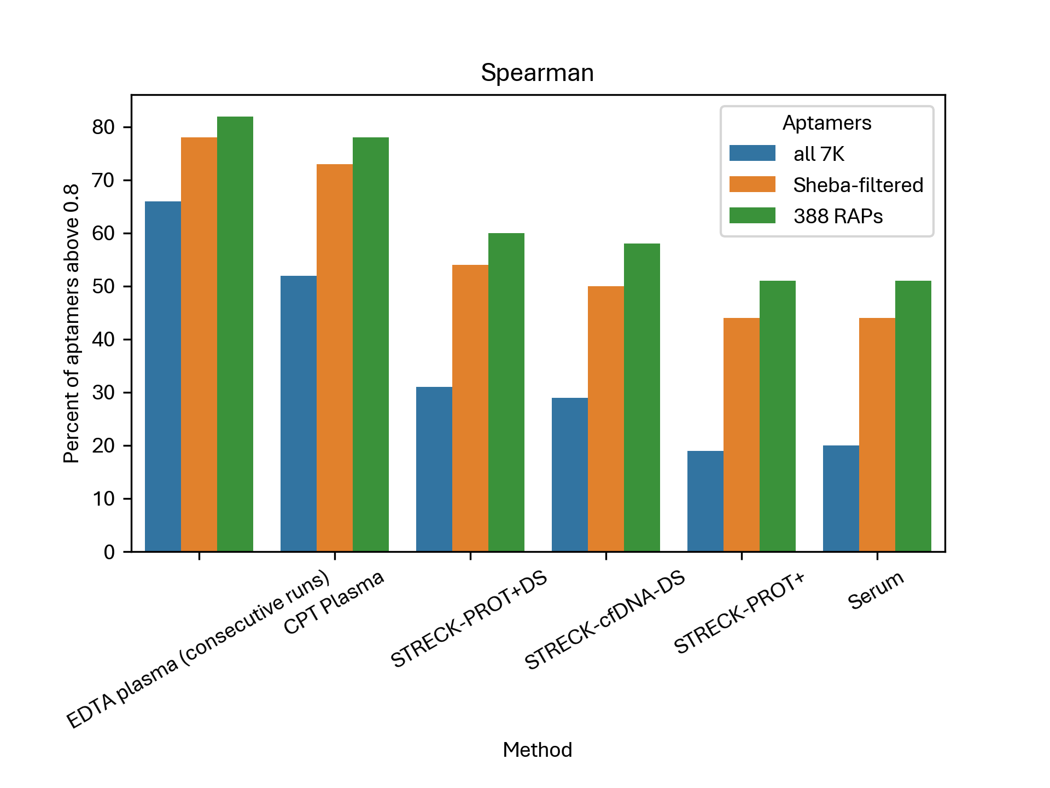
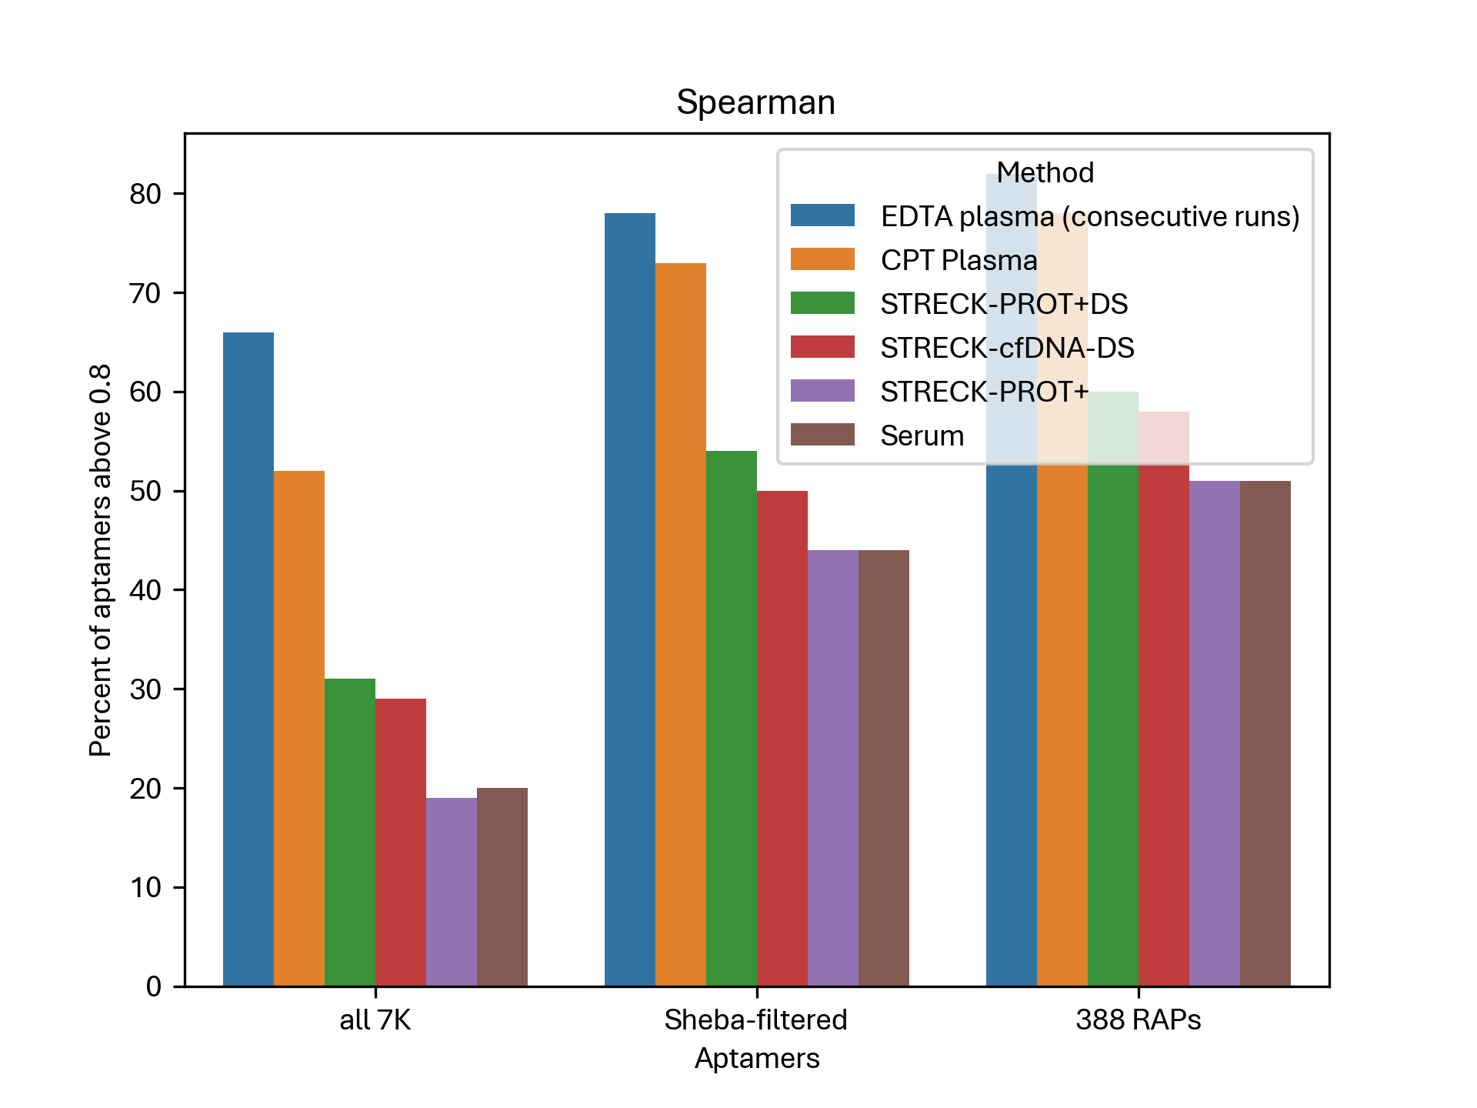
Spearman correlation – Summary

Slide 15
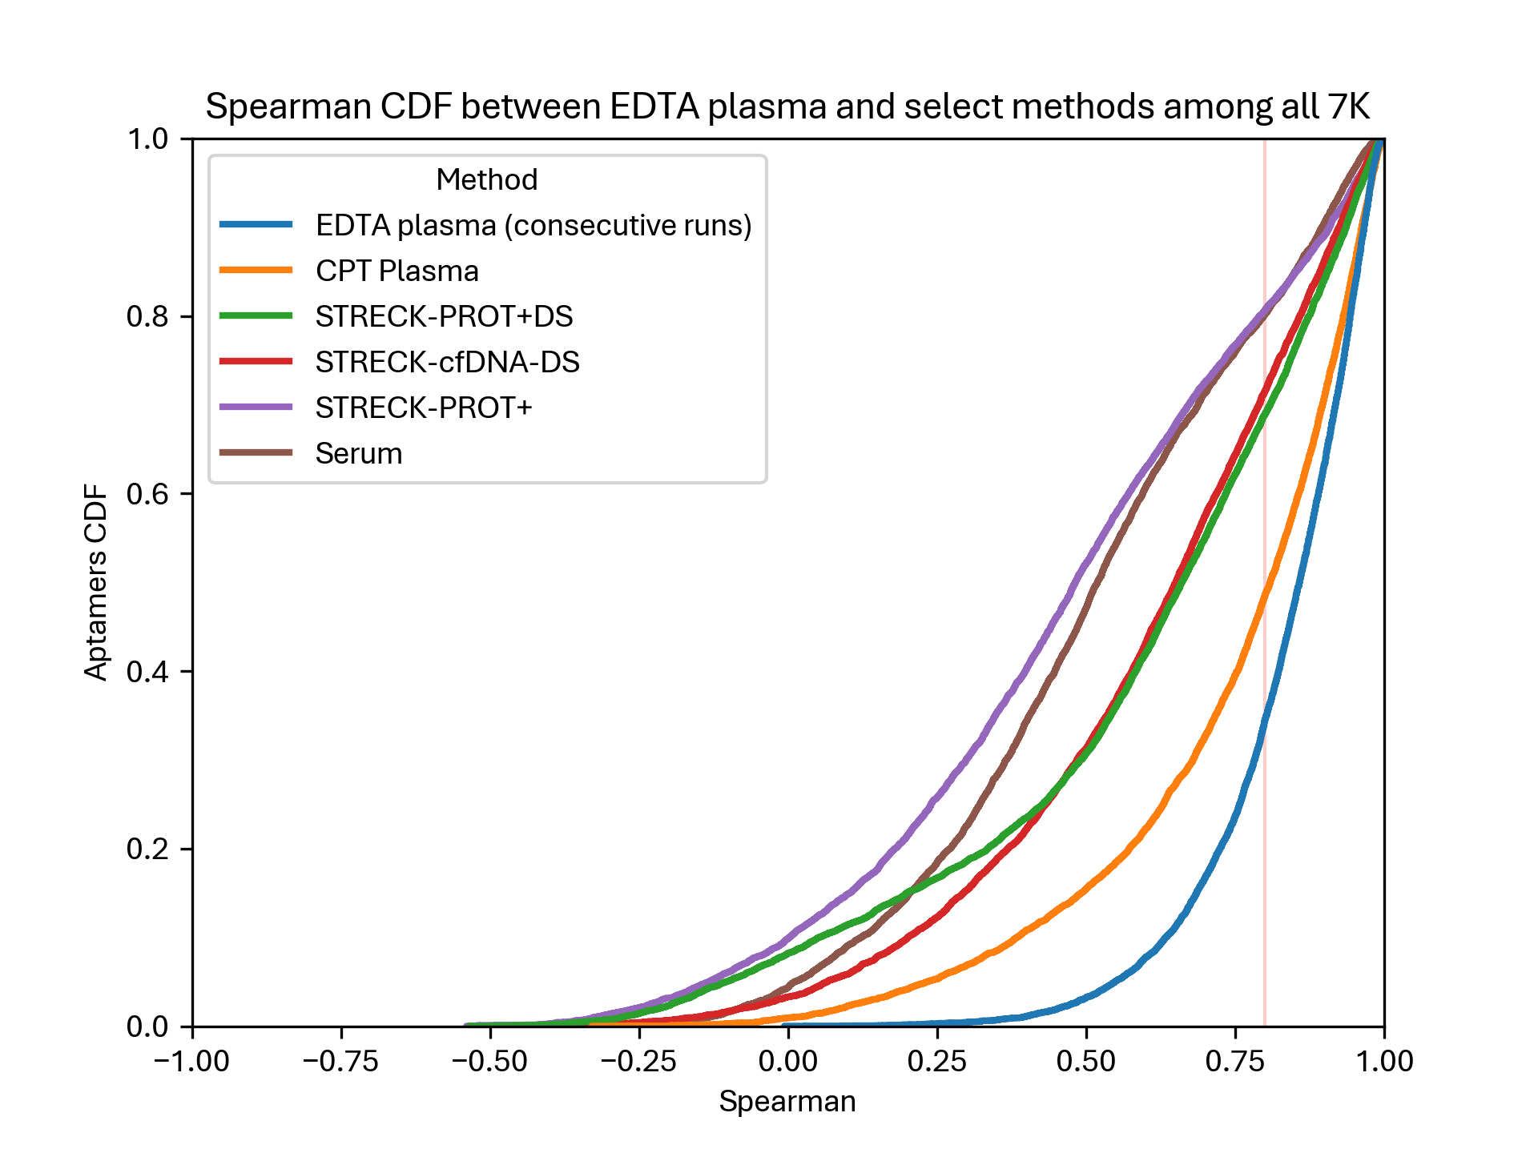
Spearman correlation – All 7K

Slide 16
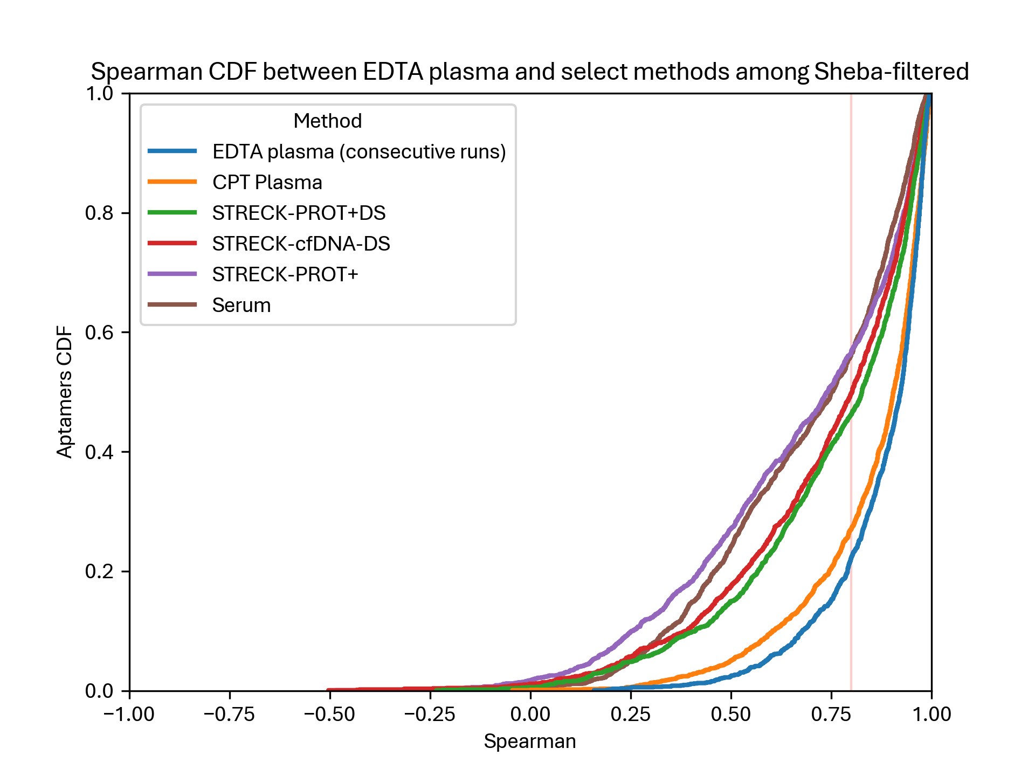
Spearman correlation – Sheba

Slide 17
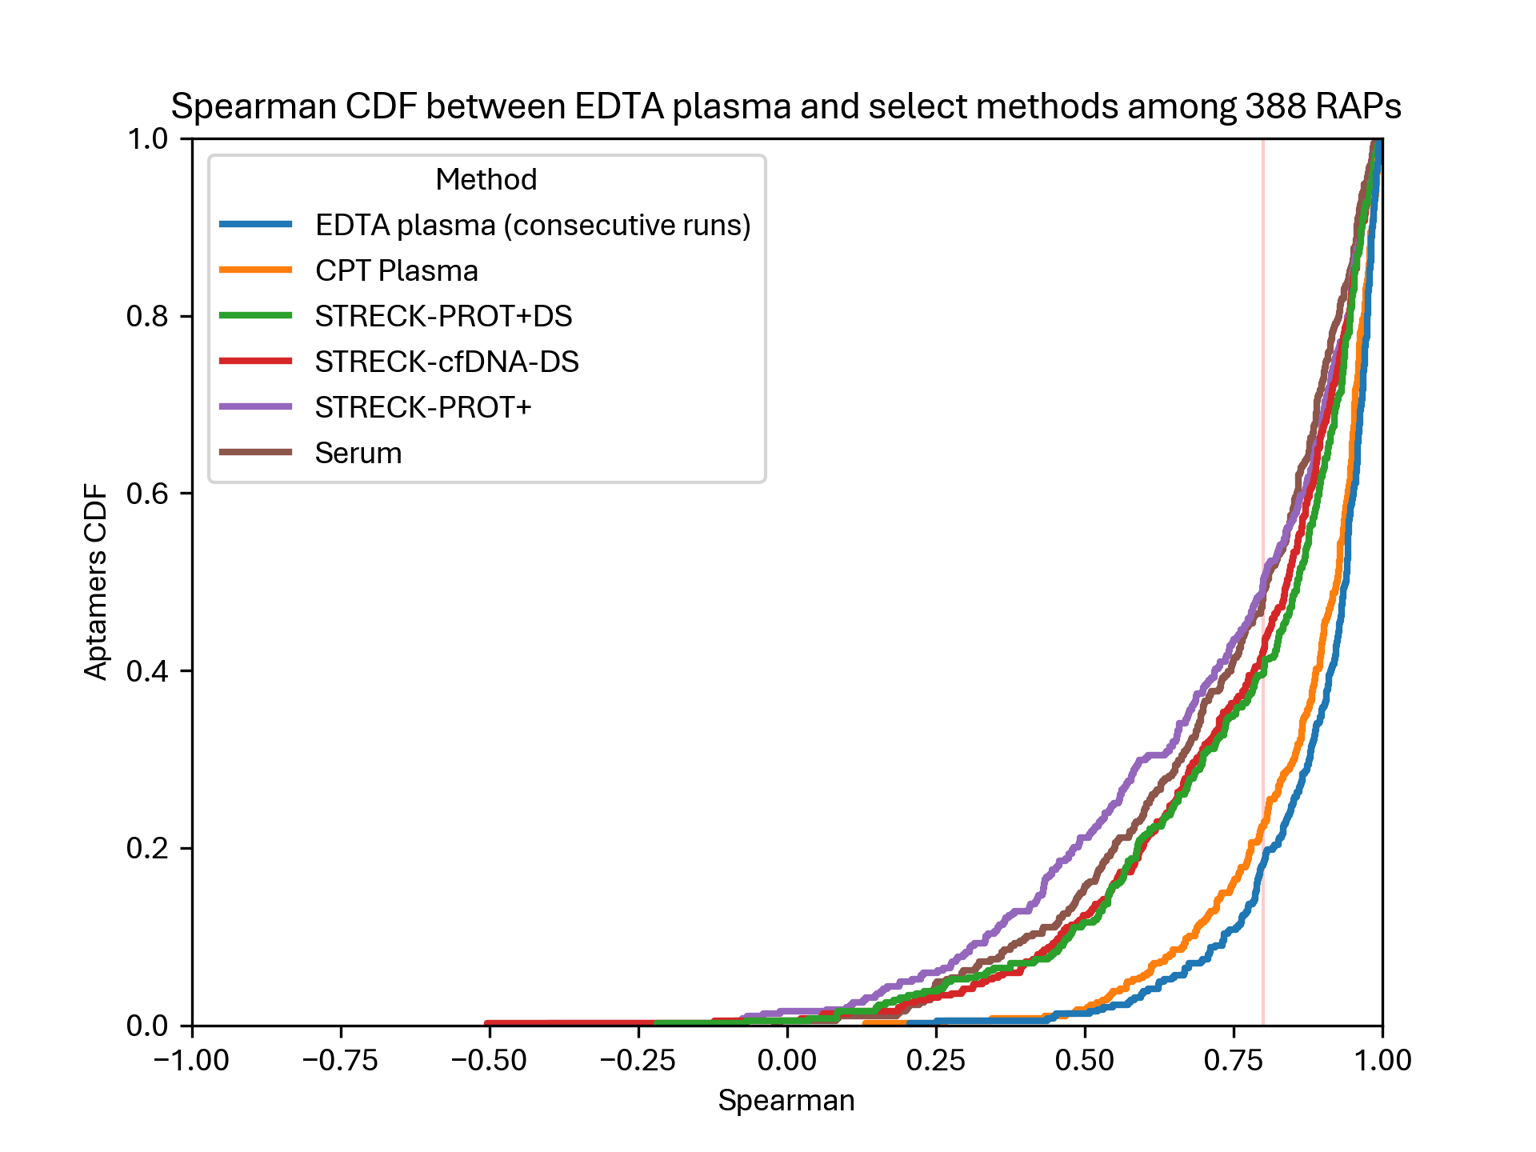
Spearman correlation – RAPs

Slide 18
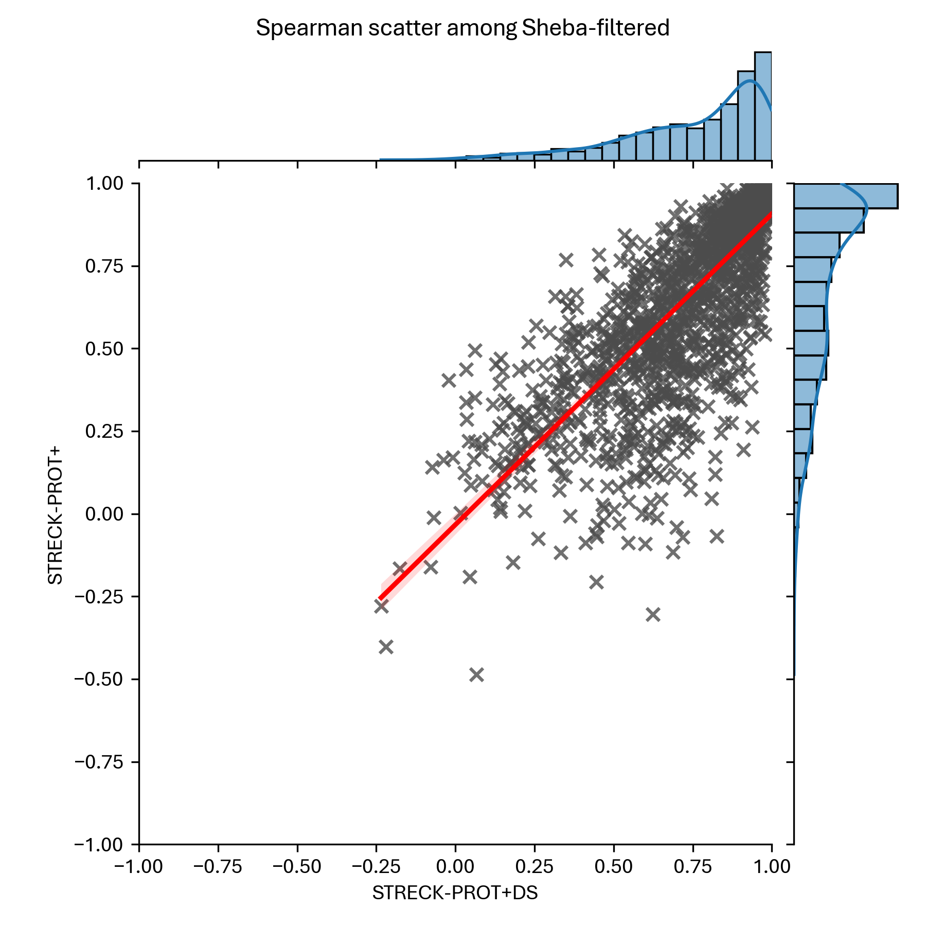
Spearman correlation – With/Without DS

Slide 19
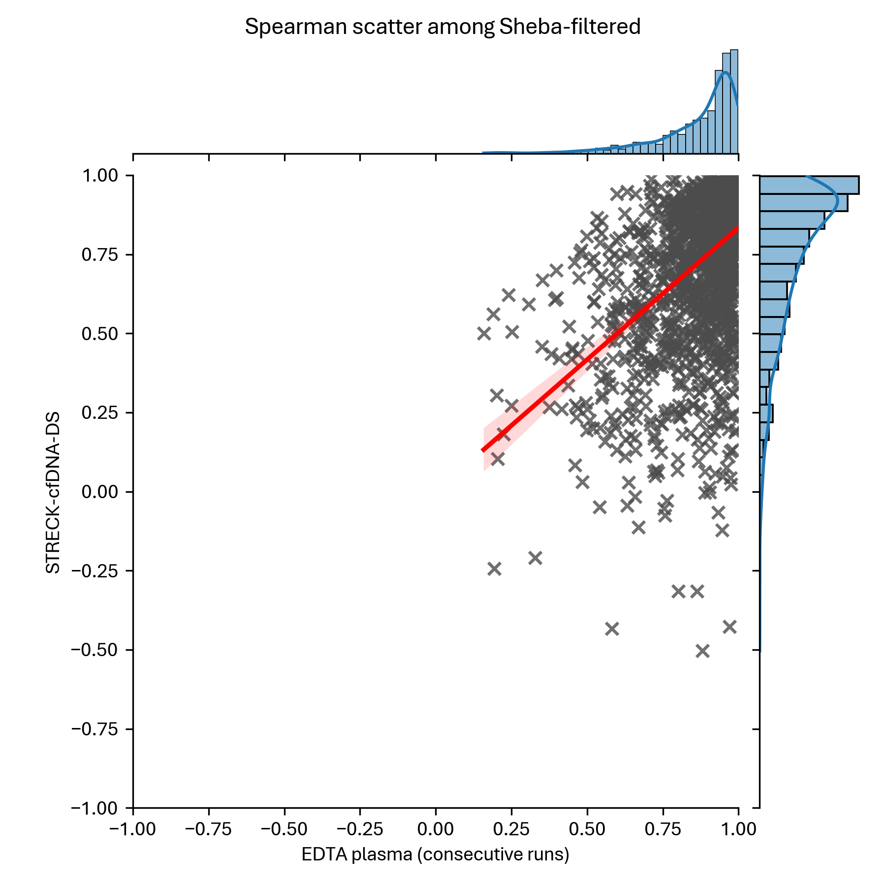
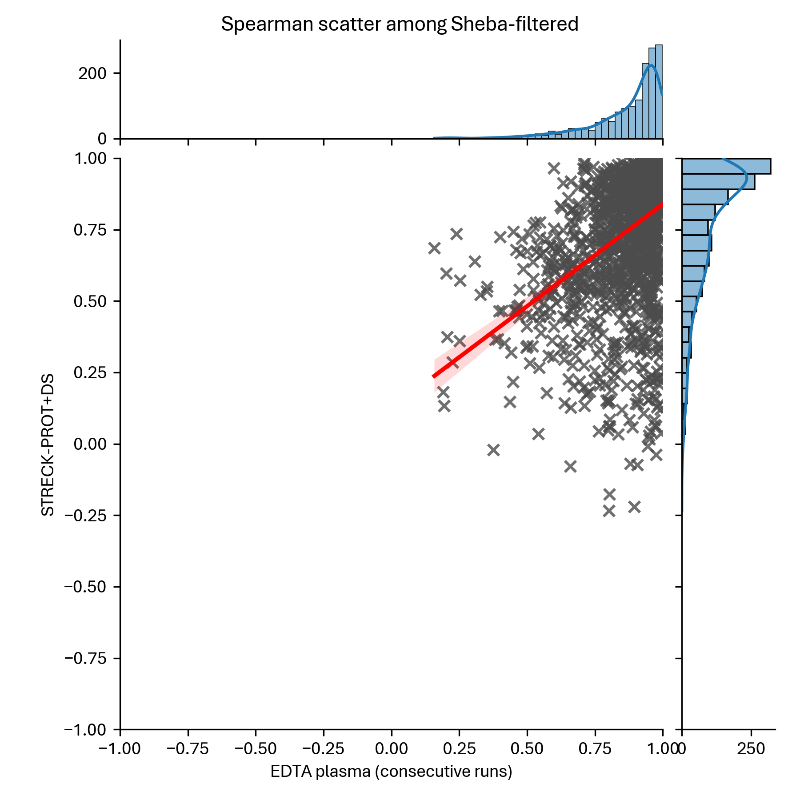
Spearman correlation – Streck Prot+ or cfDNA

Slide 20
Linear Regression: R^2

Slide 21
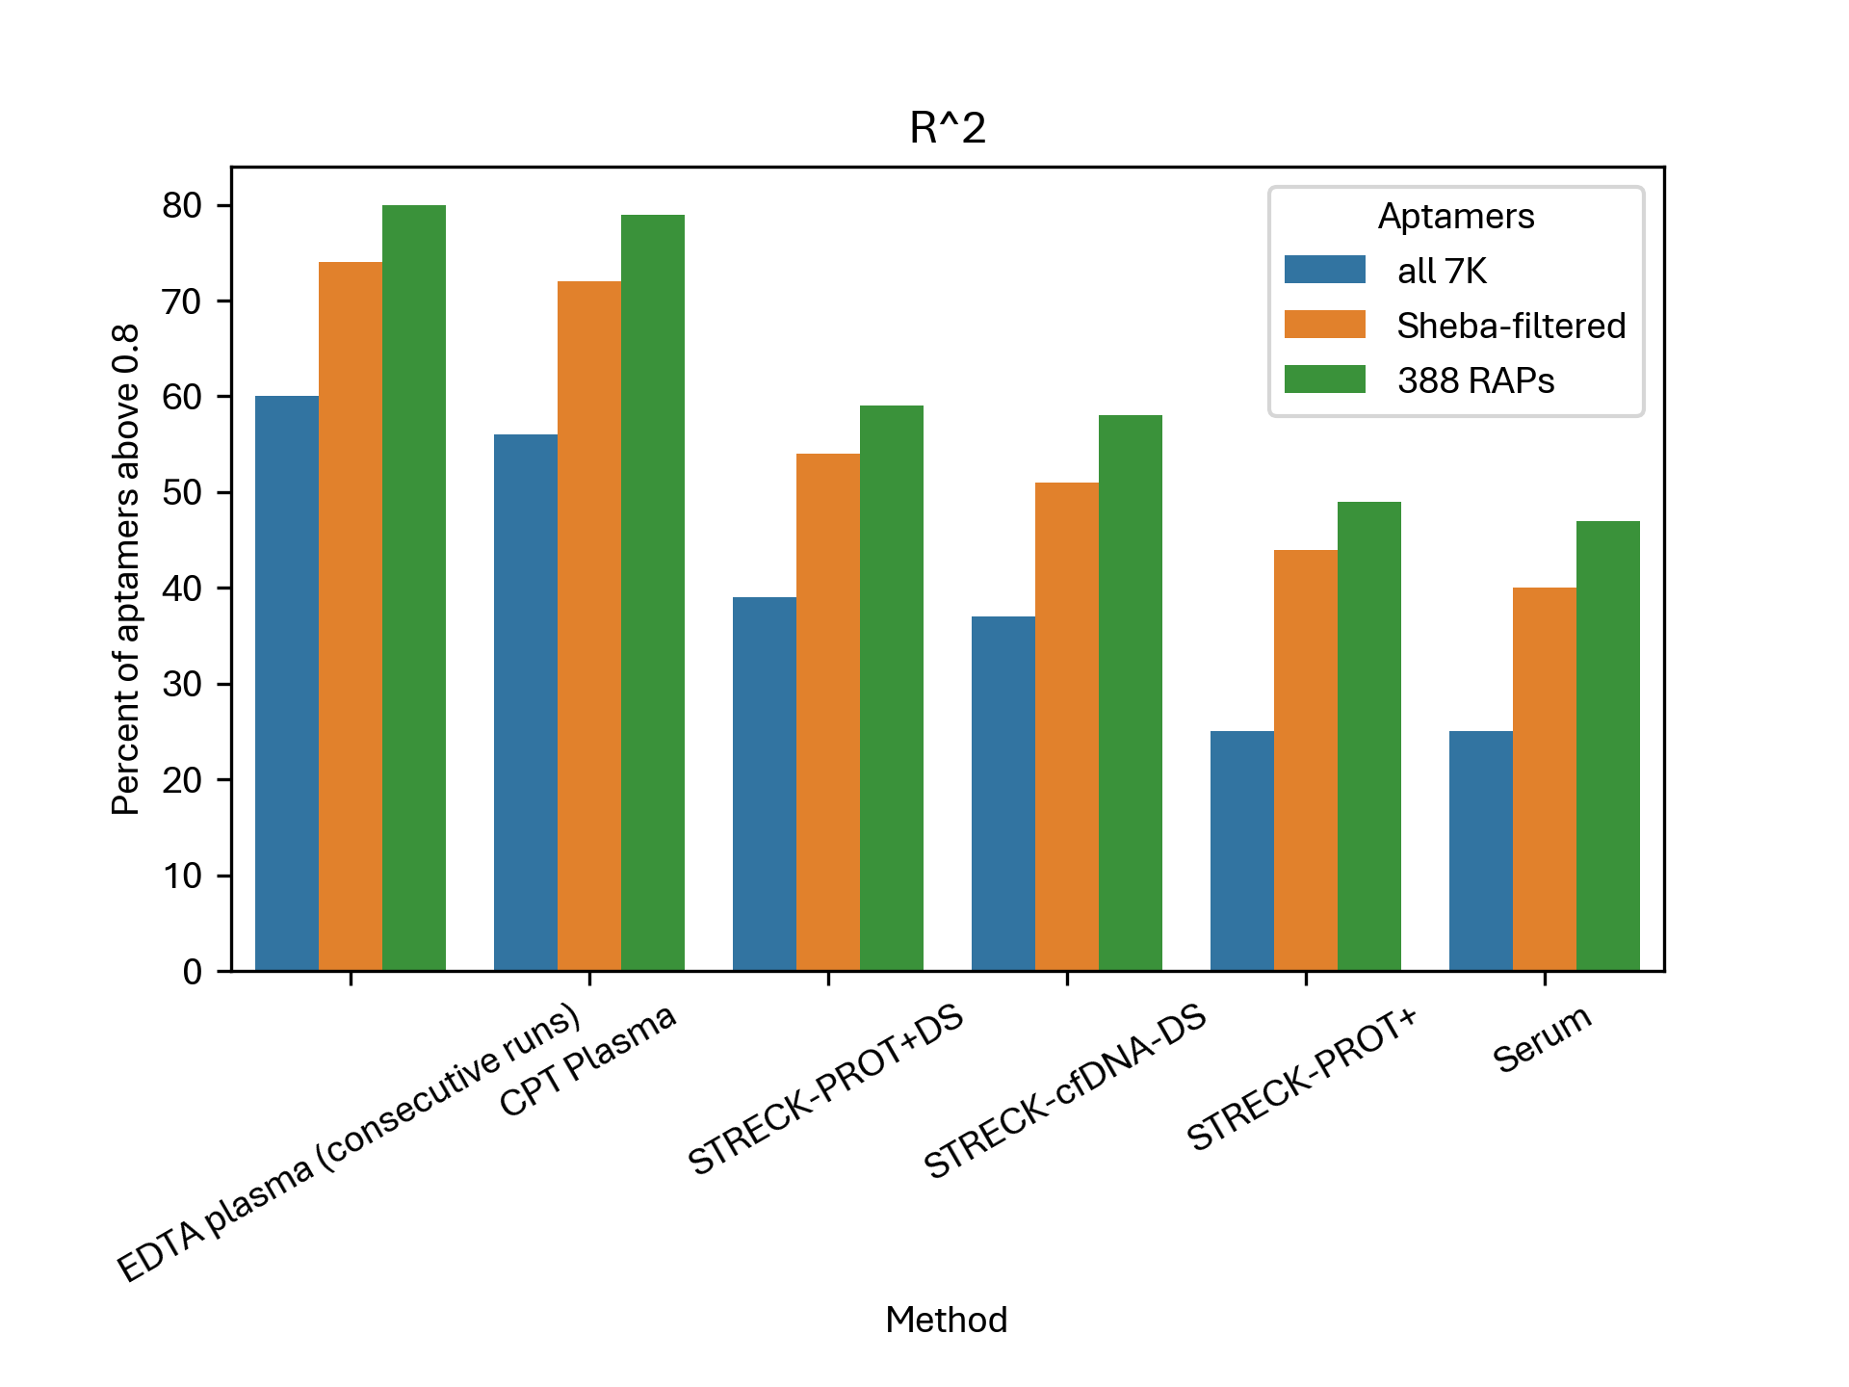
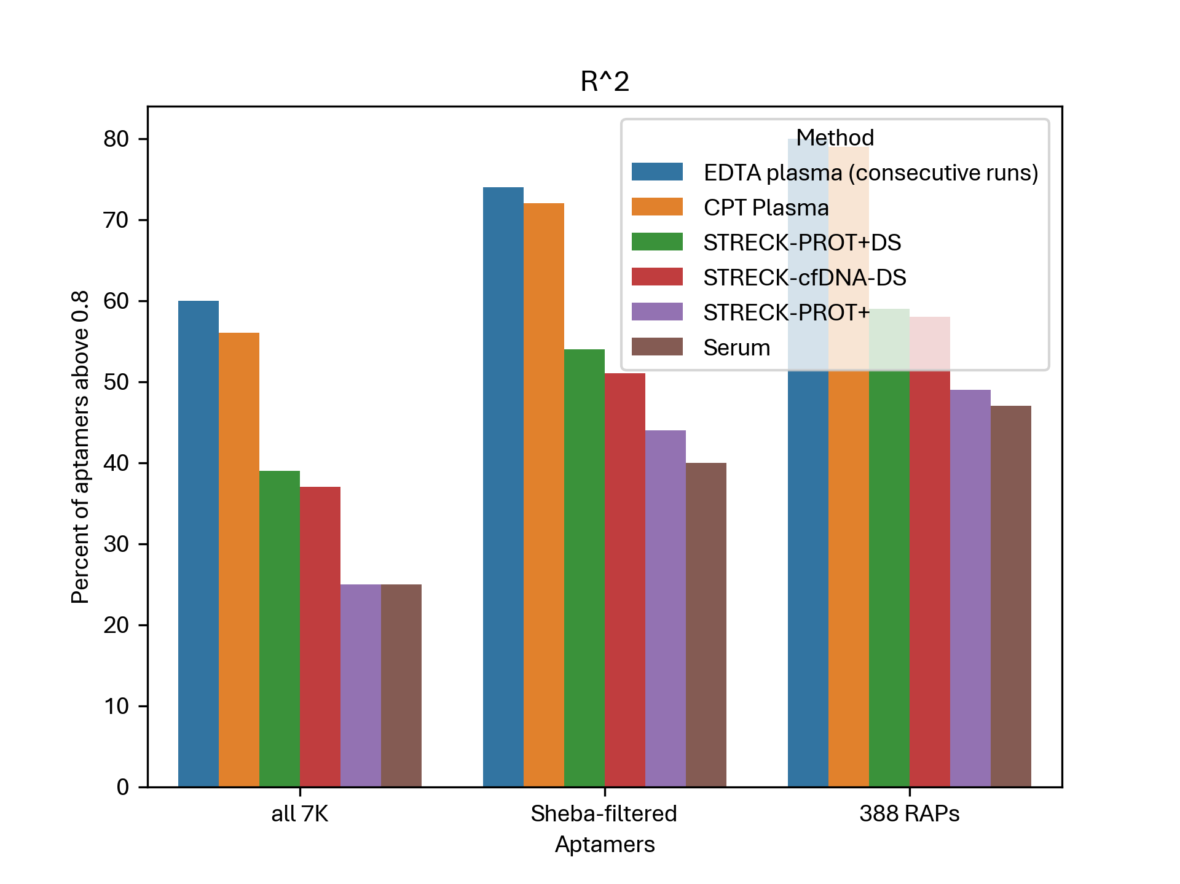
Linear Regression: R^2 – Summary

Slide 22
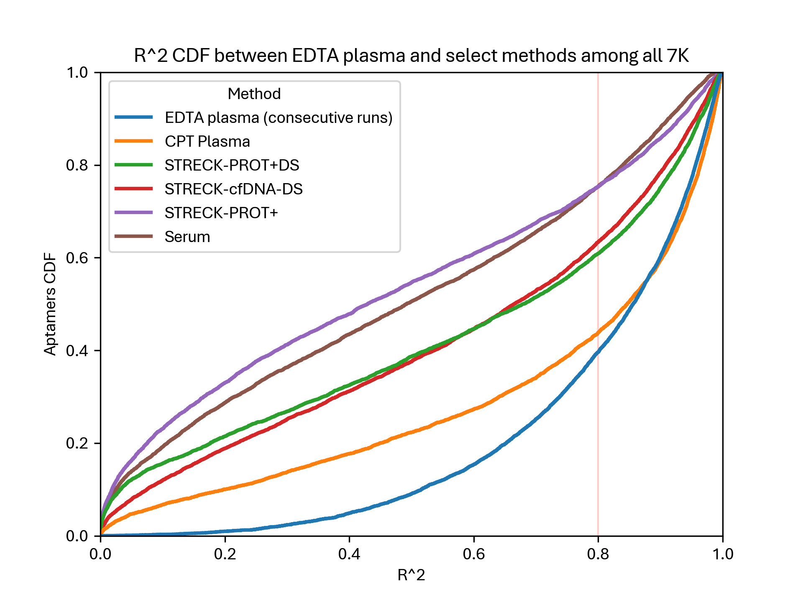
Linear Regression: R^2 – All 7K

Slide 23
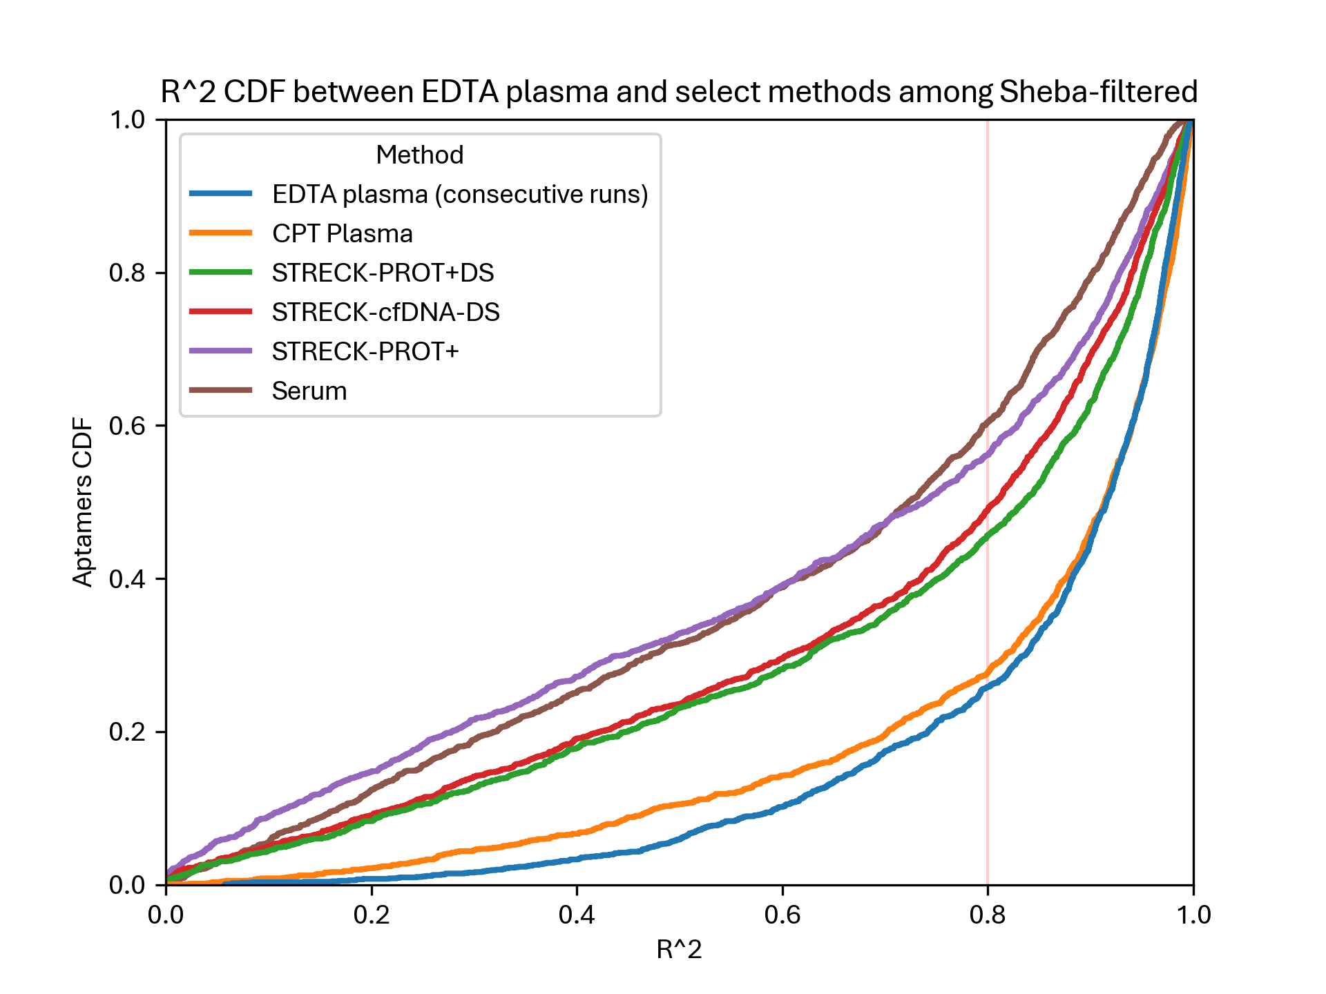
Linear Regression: R^2 – Sheba

Slide 24
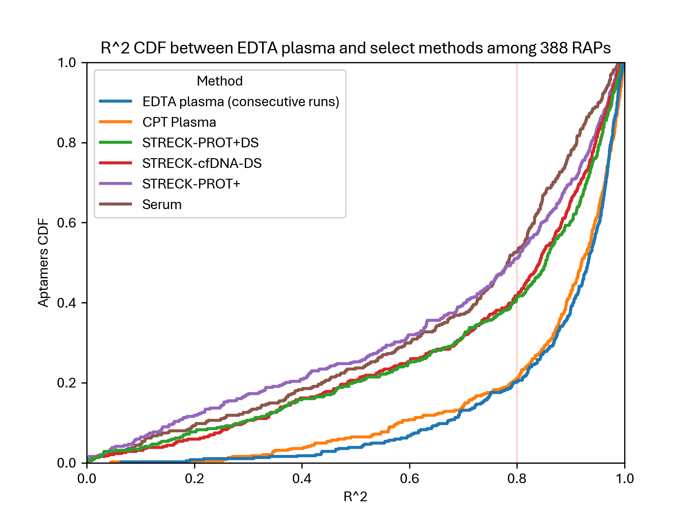
Linear Regression: R^2 – RAPs

Slide 25
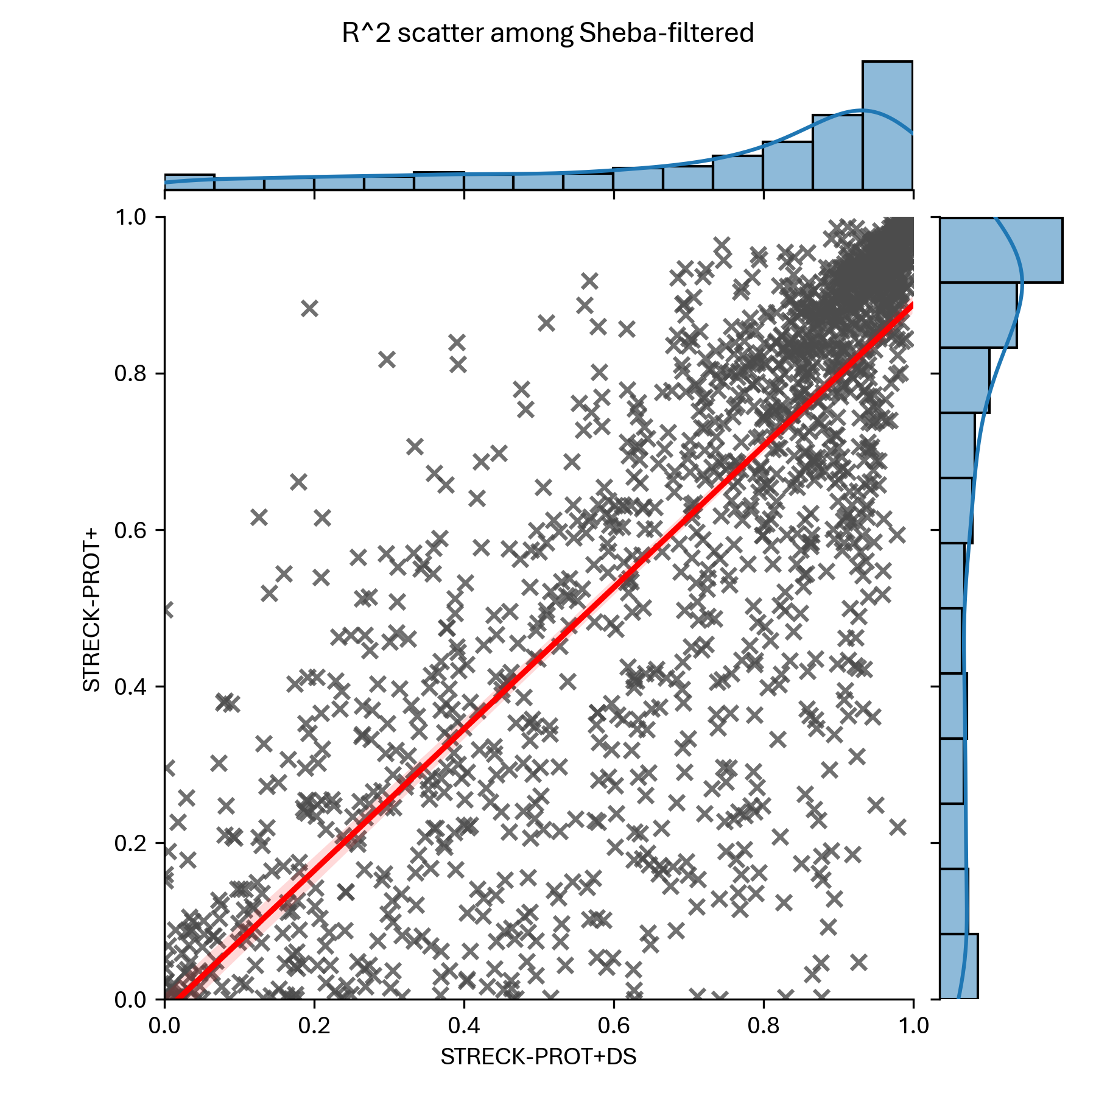
R^2 – With/Without DS

Slide 26
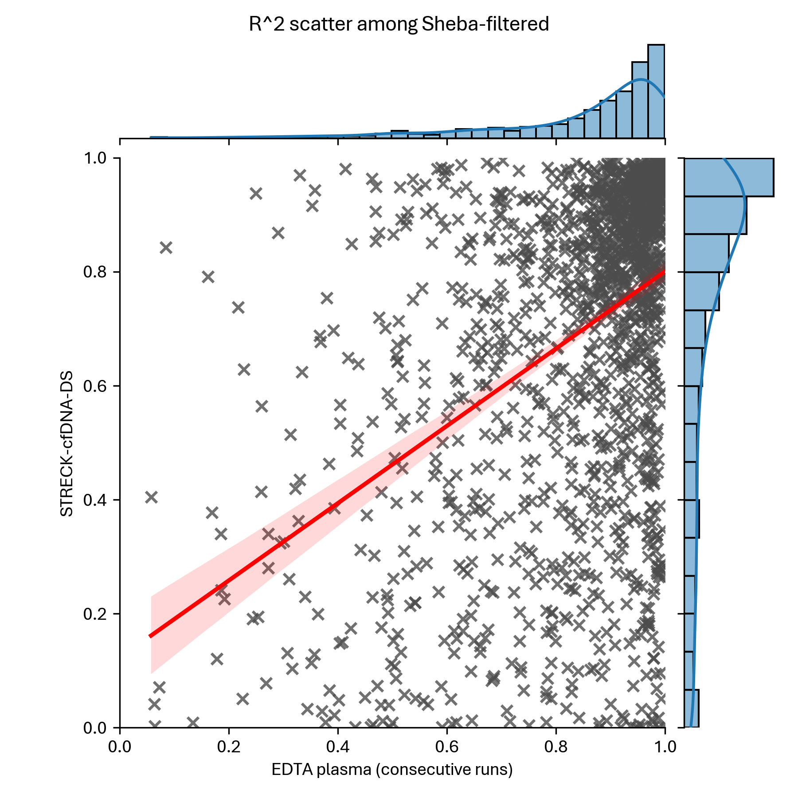
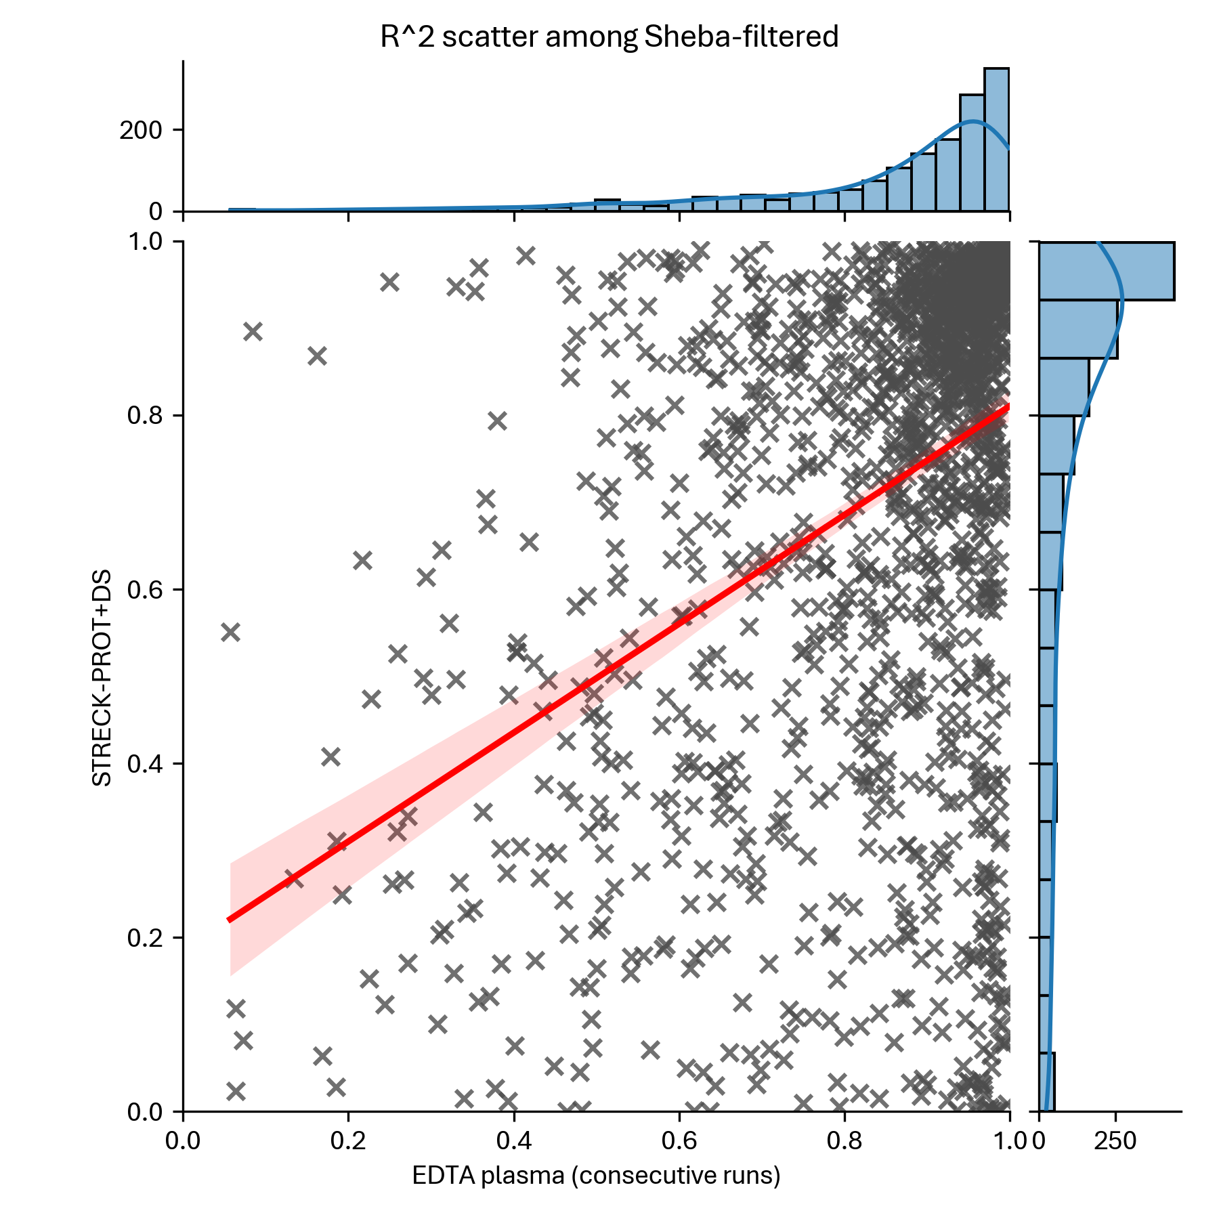
R^2 – Streck Prot+ or cfDNA

Slide 27
Linear Regression: Slope

Slide 28
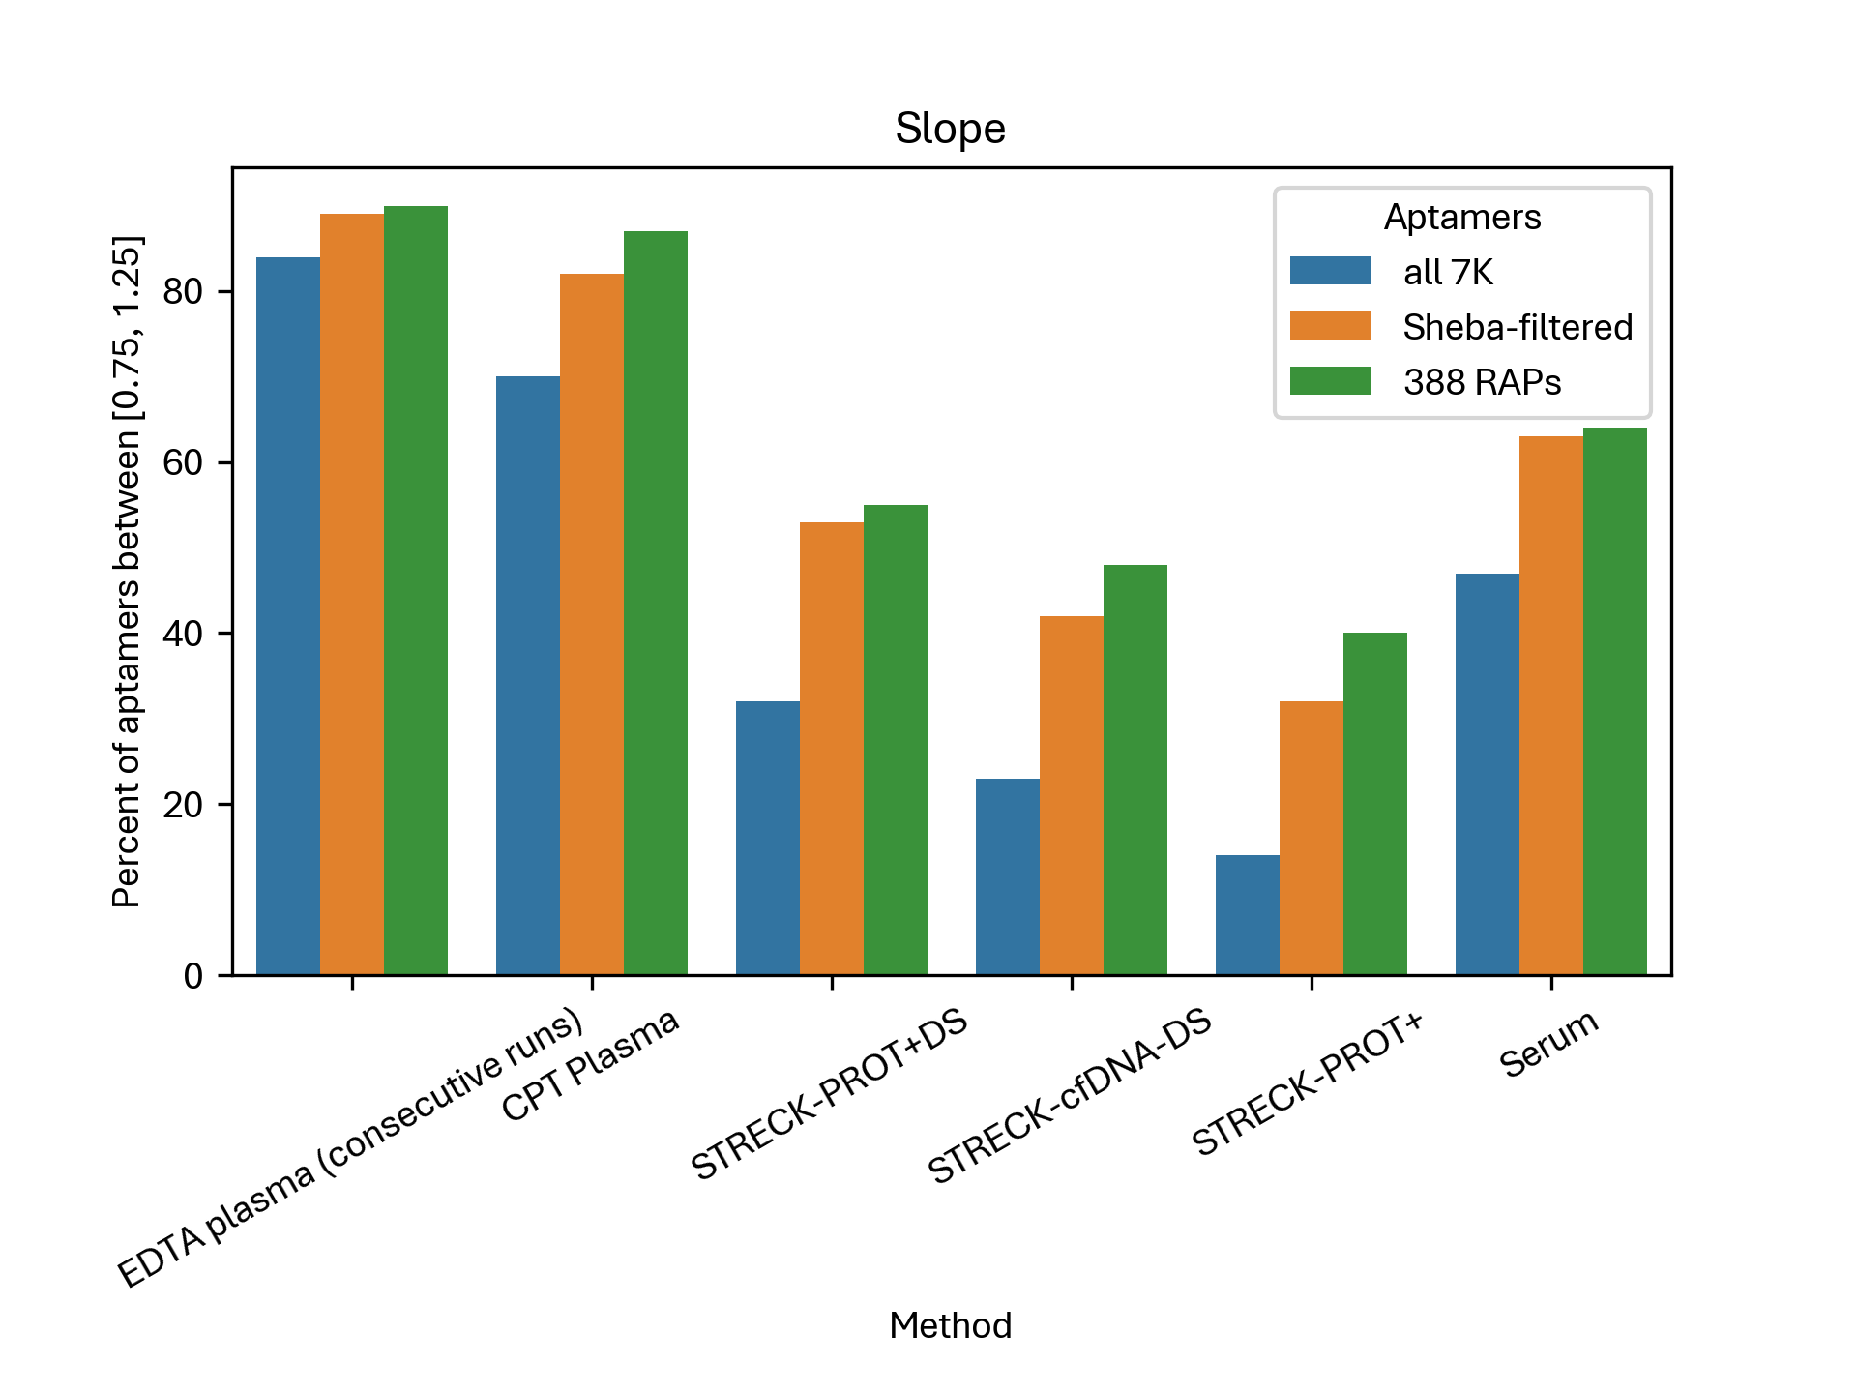
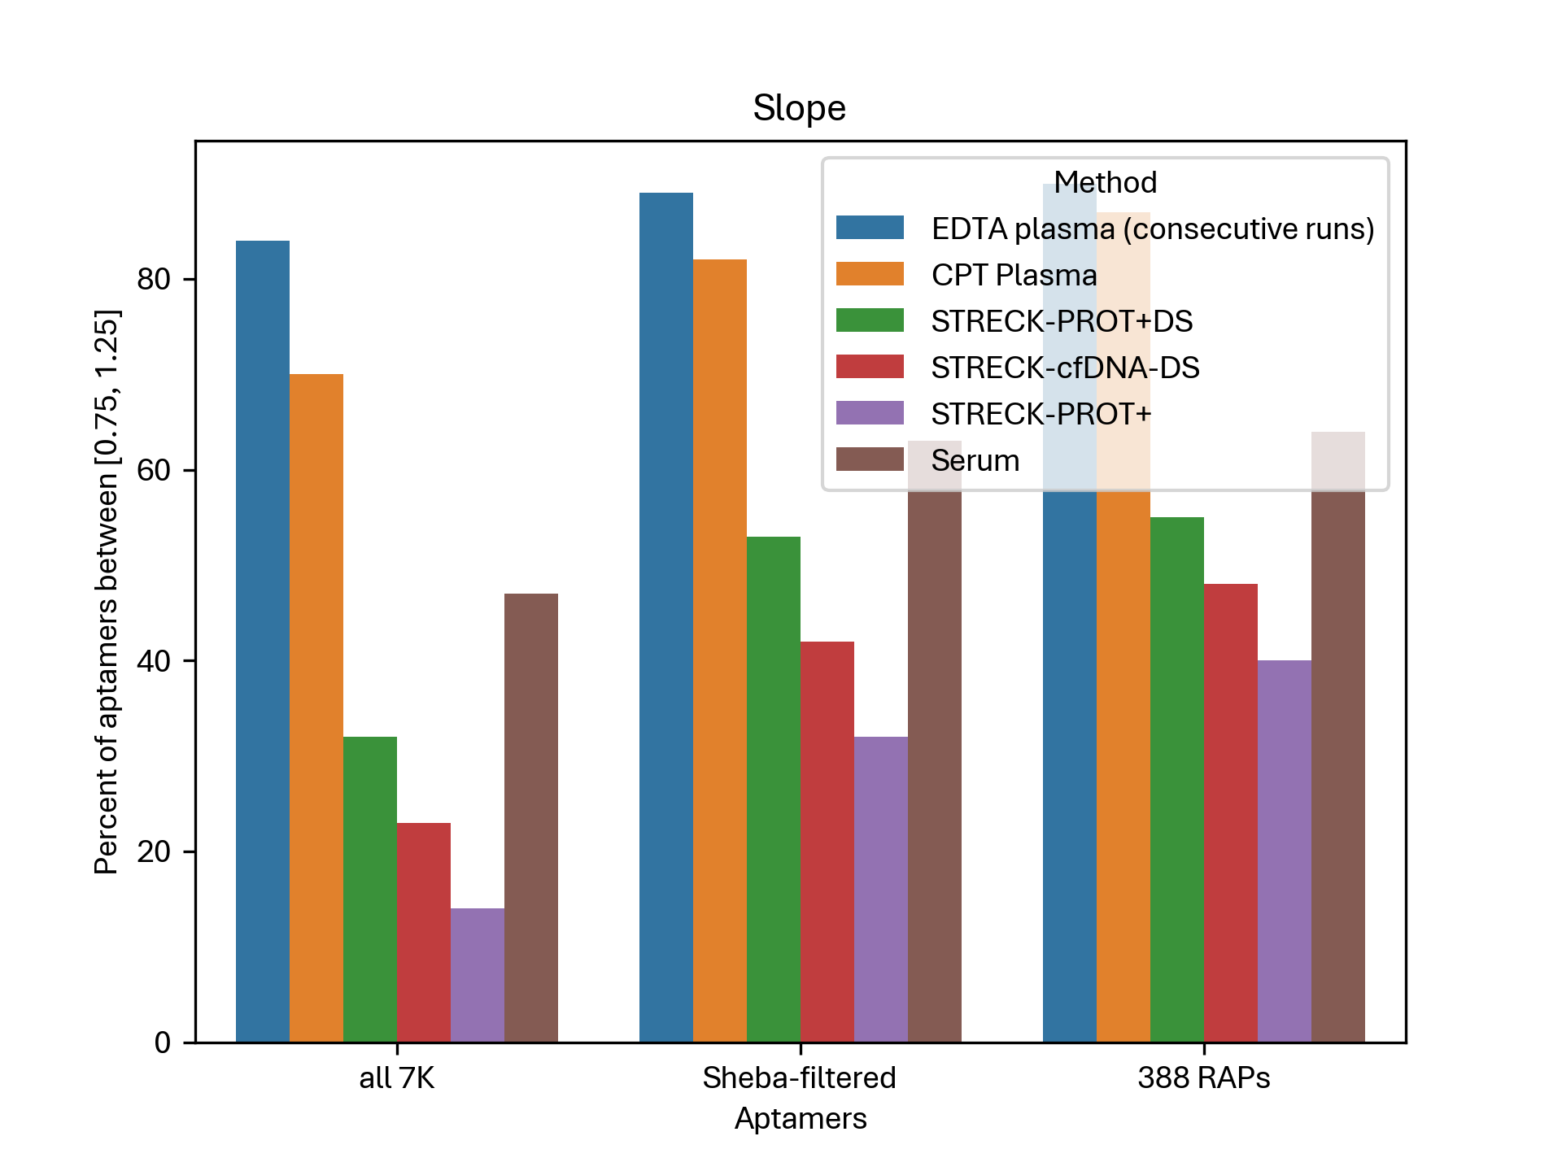
Linear Regression: Slope – Summary

Slide 29
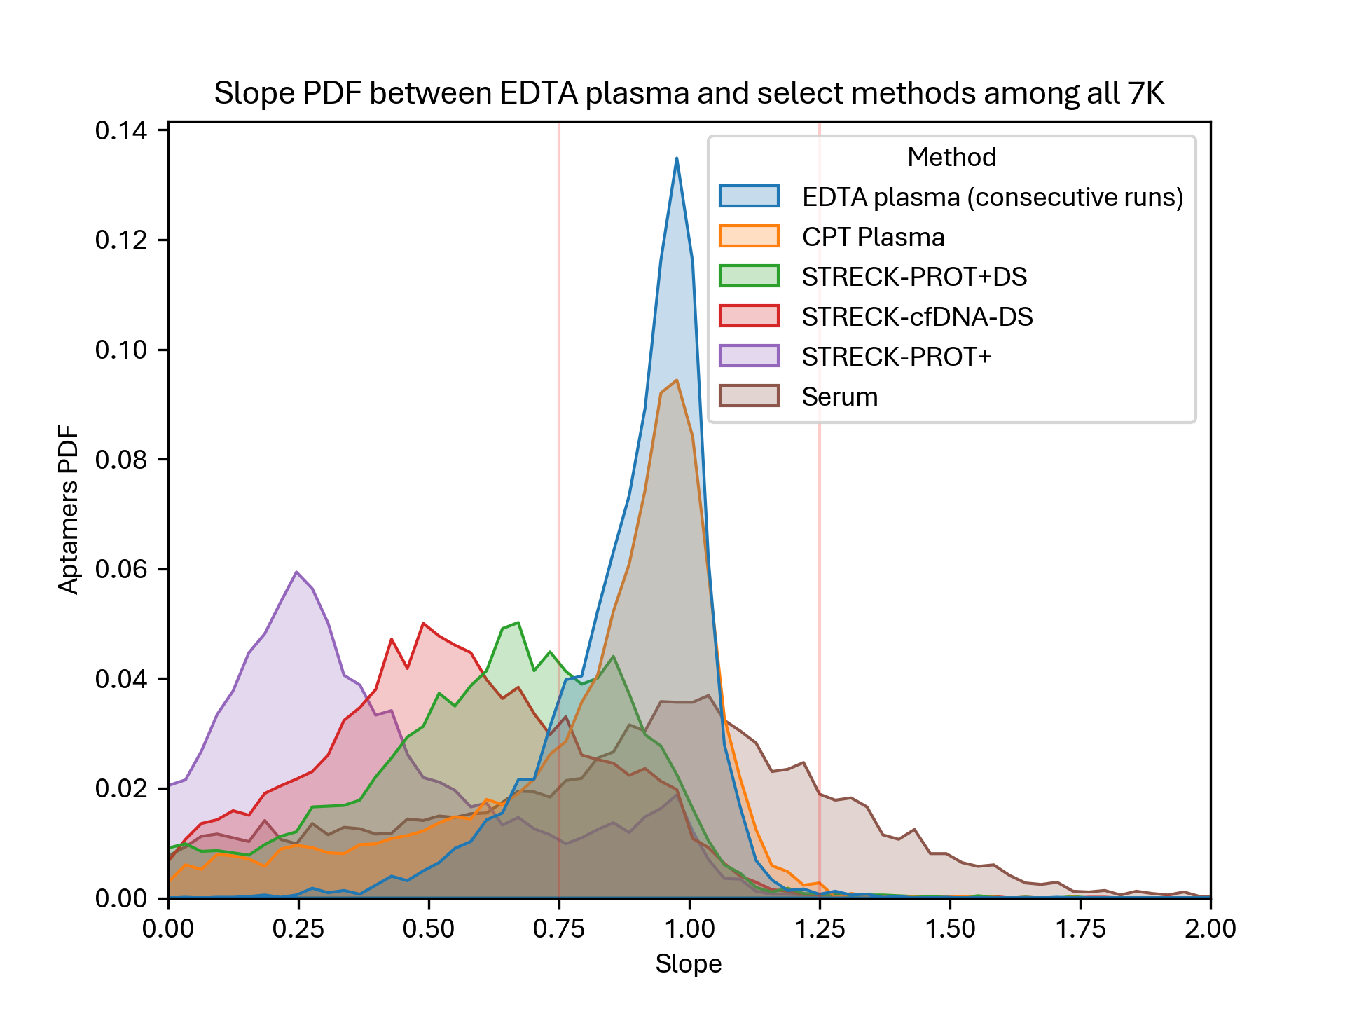
Linear Regression: Slope – All 7K

Slide 30
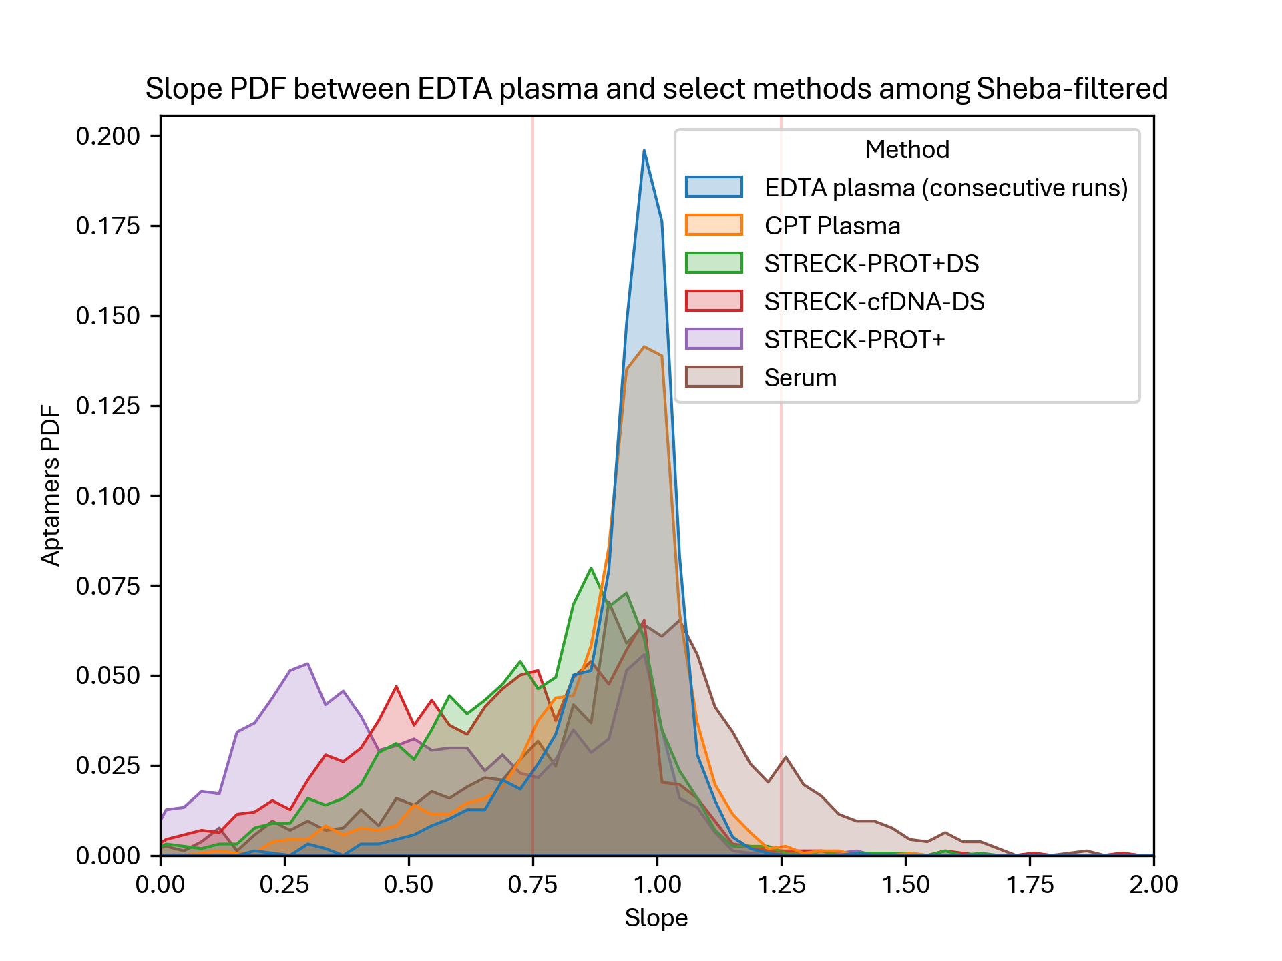
Linear Regression: Slope – Sheba

Slide 31
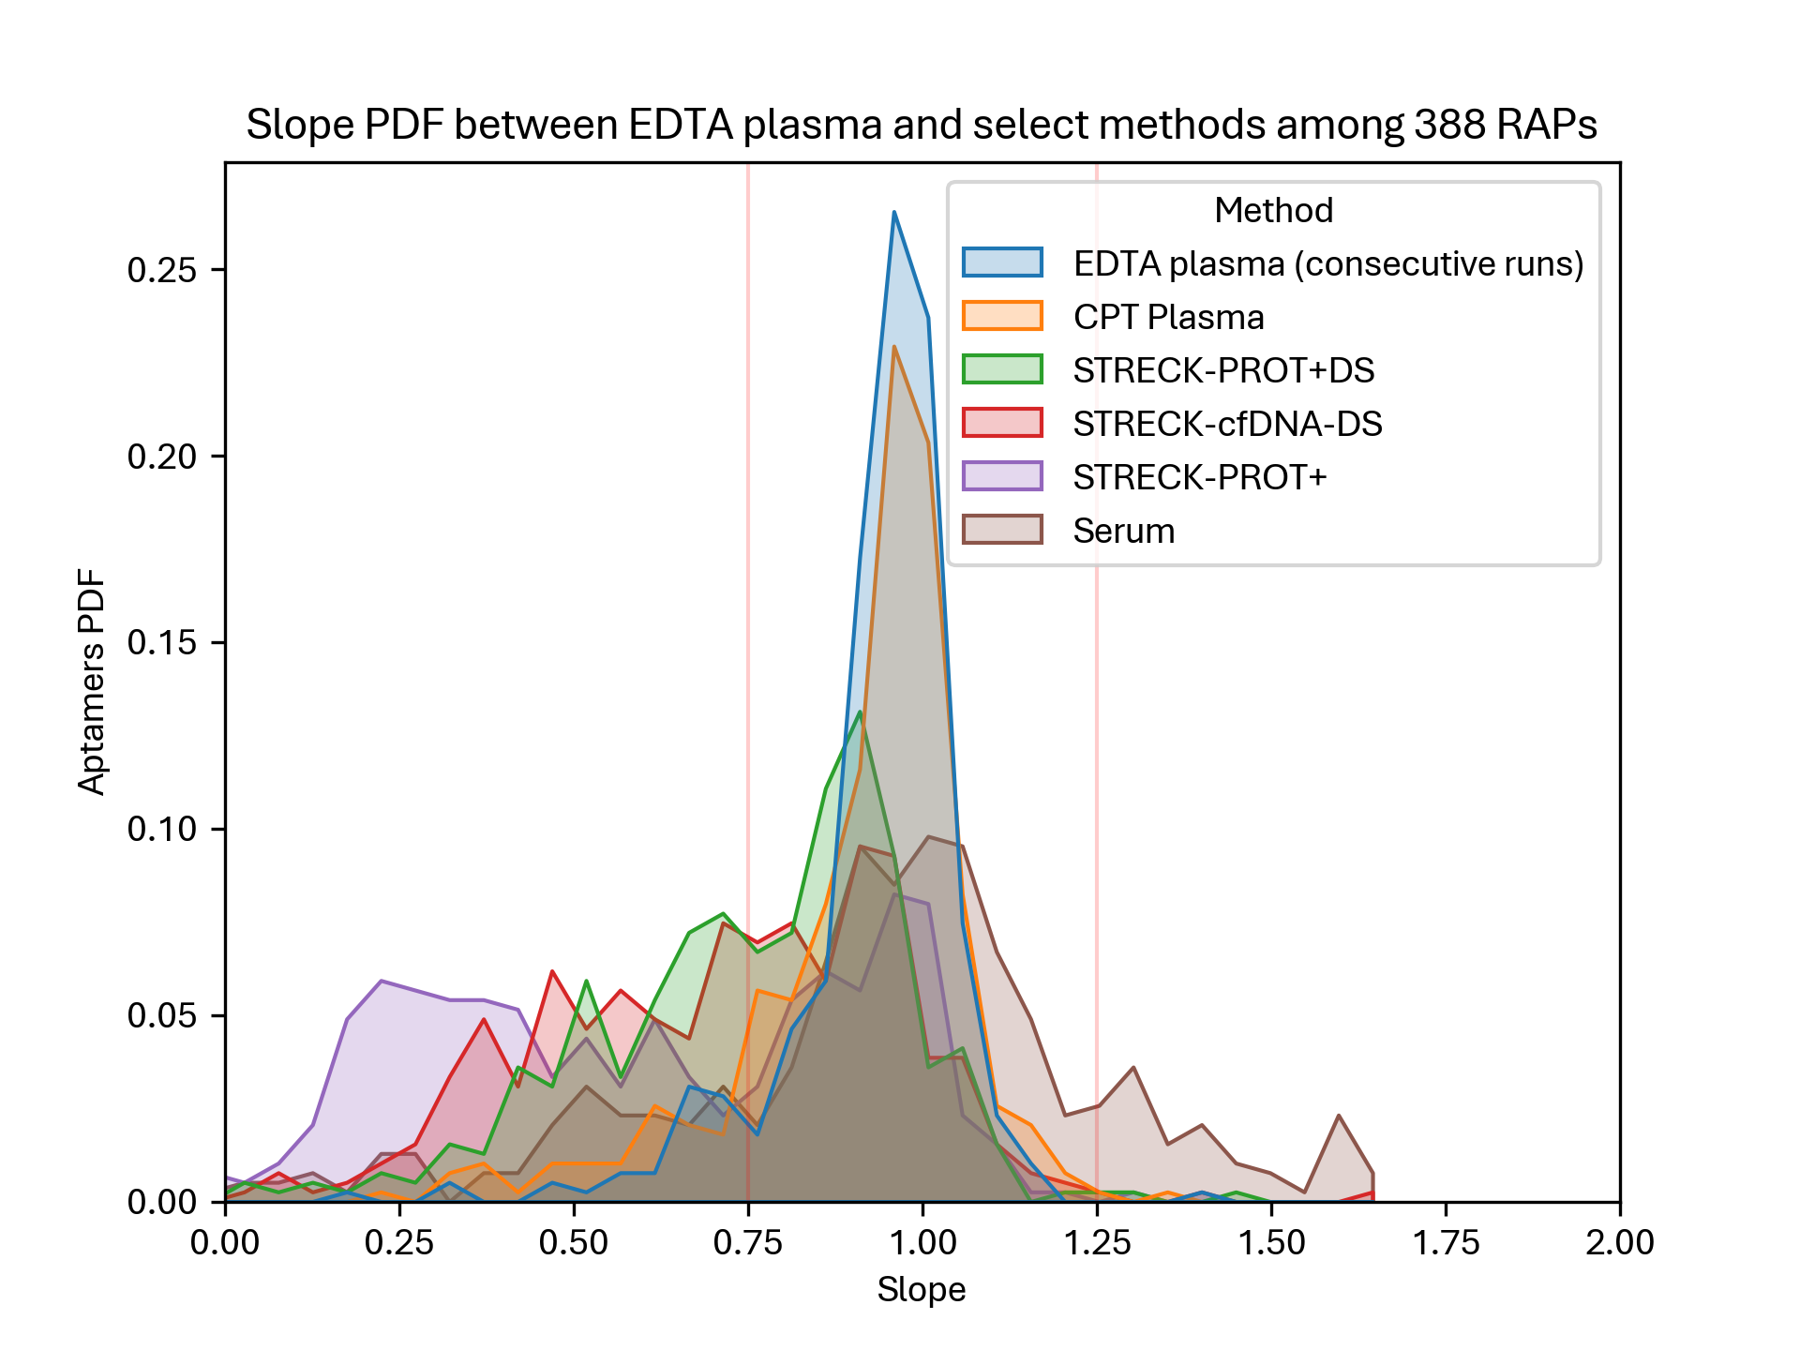
Linear Regression: Slope – RAPs

Slide 32
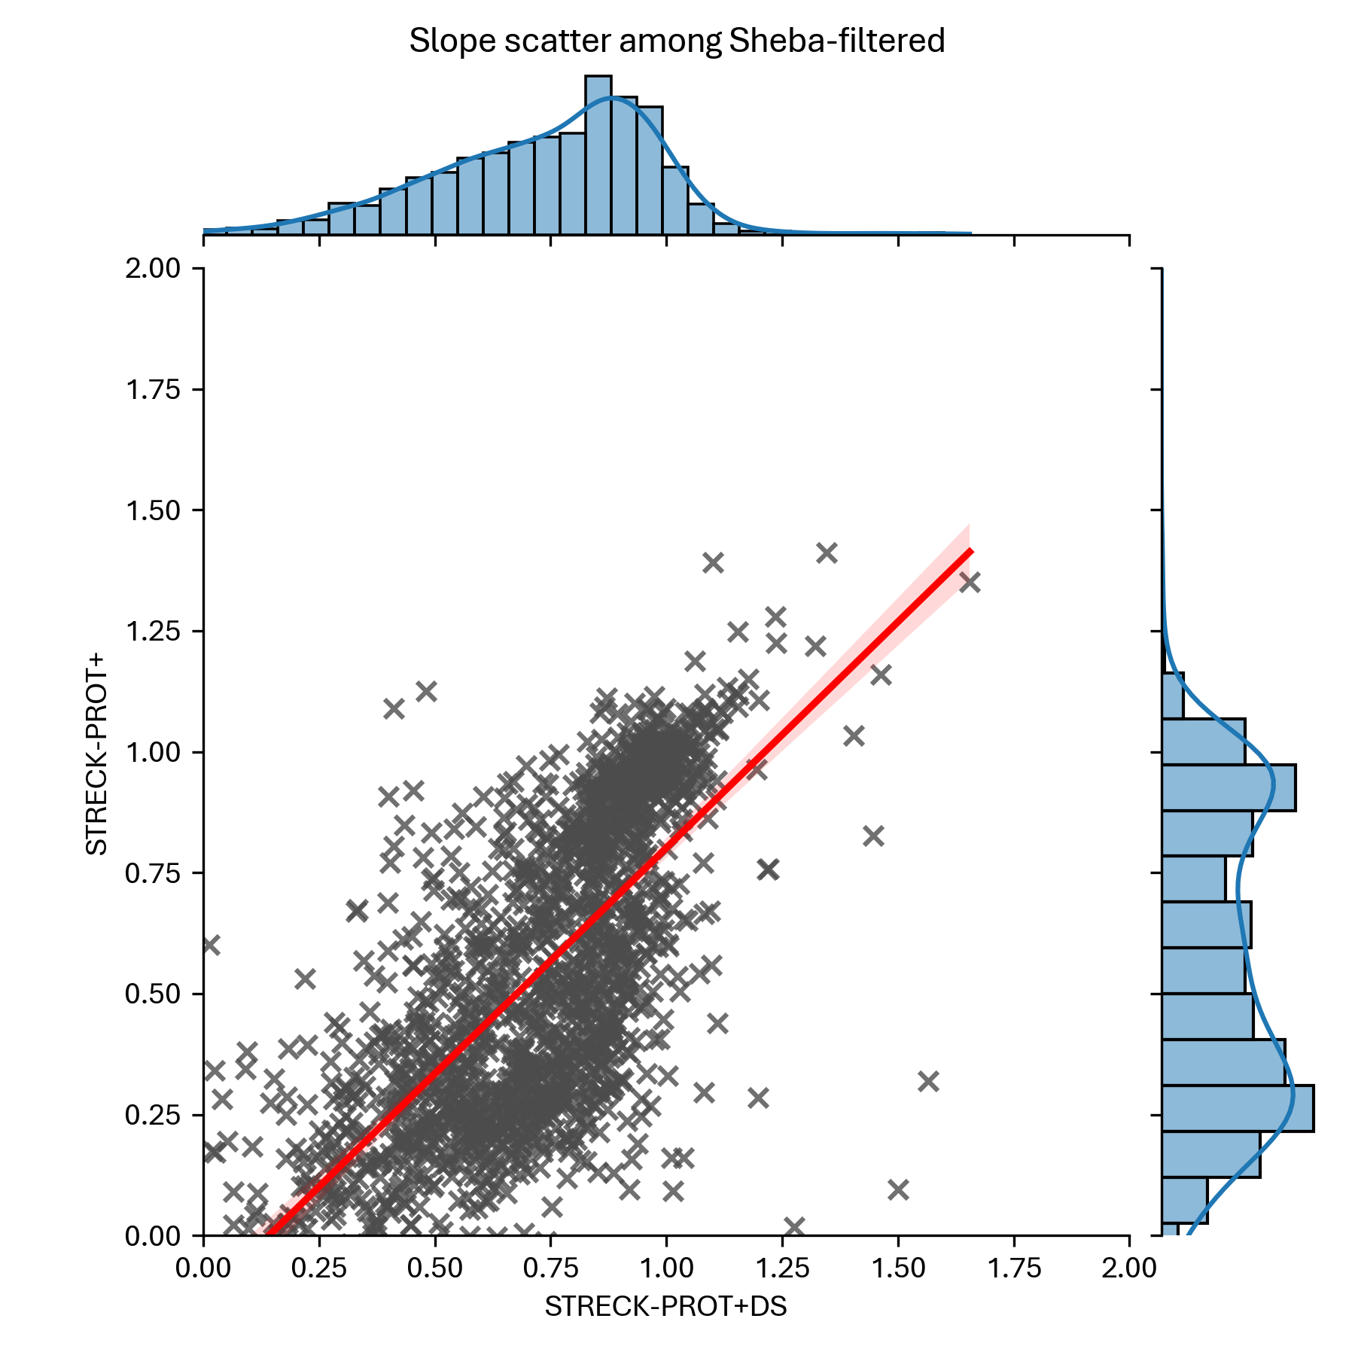
Slope – With/Without DS

Slide 33
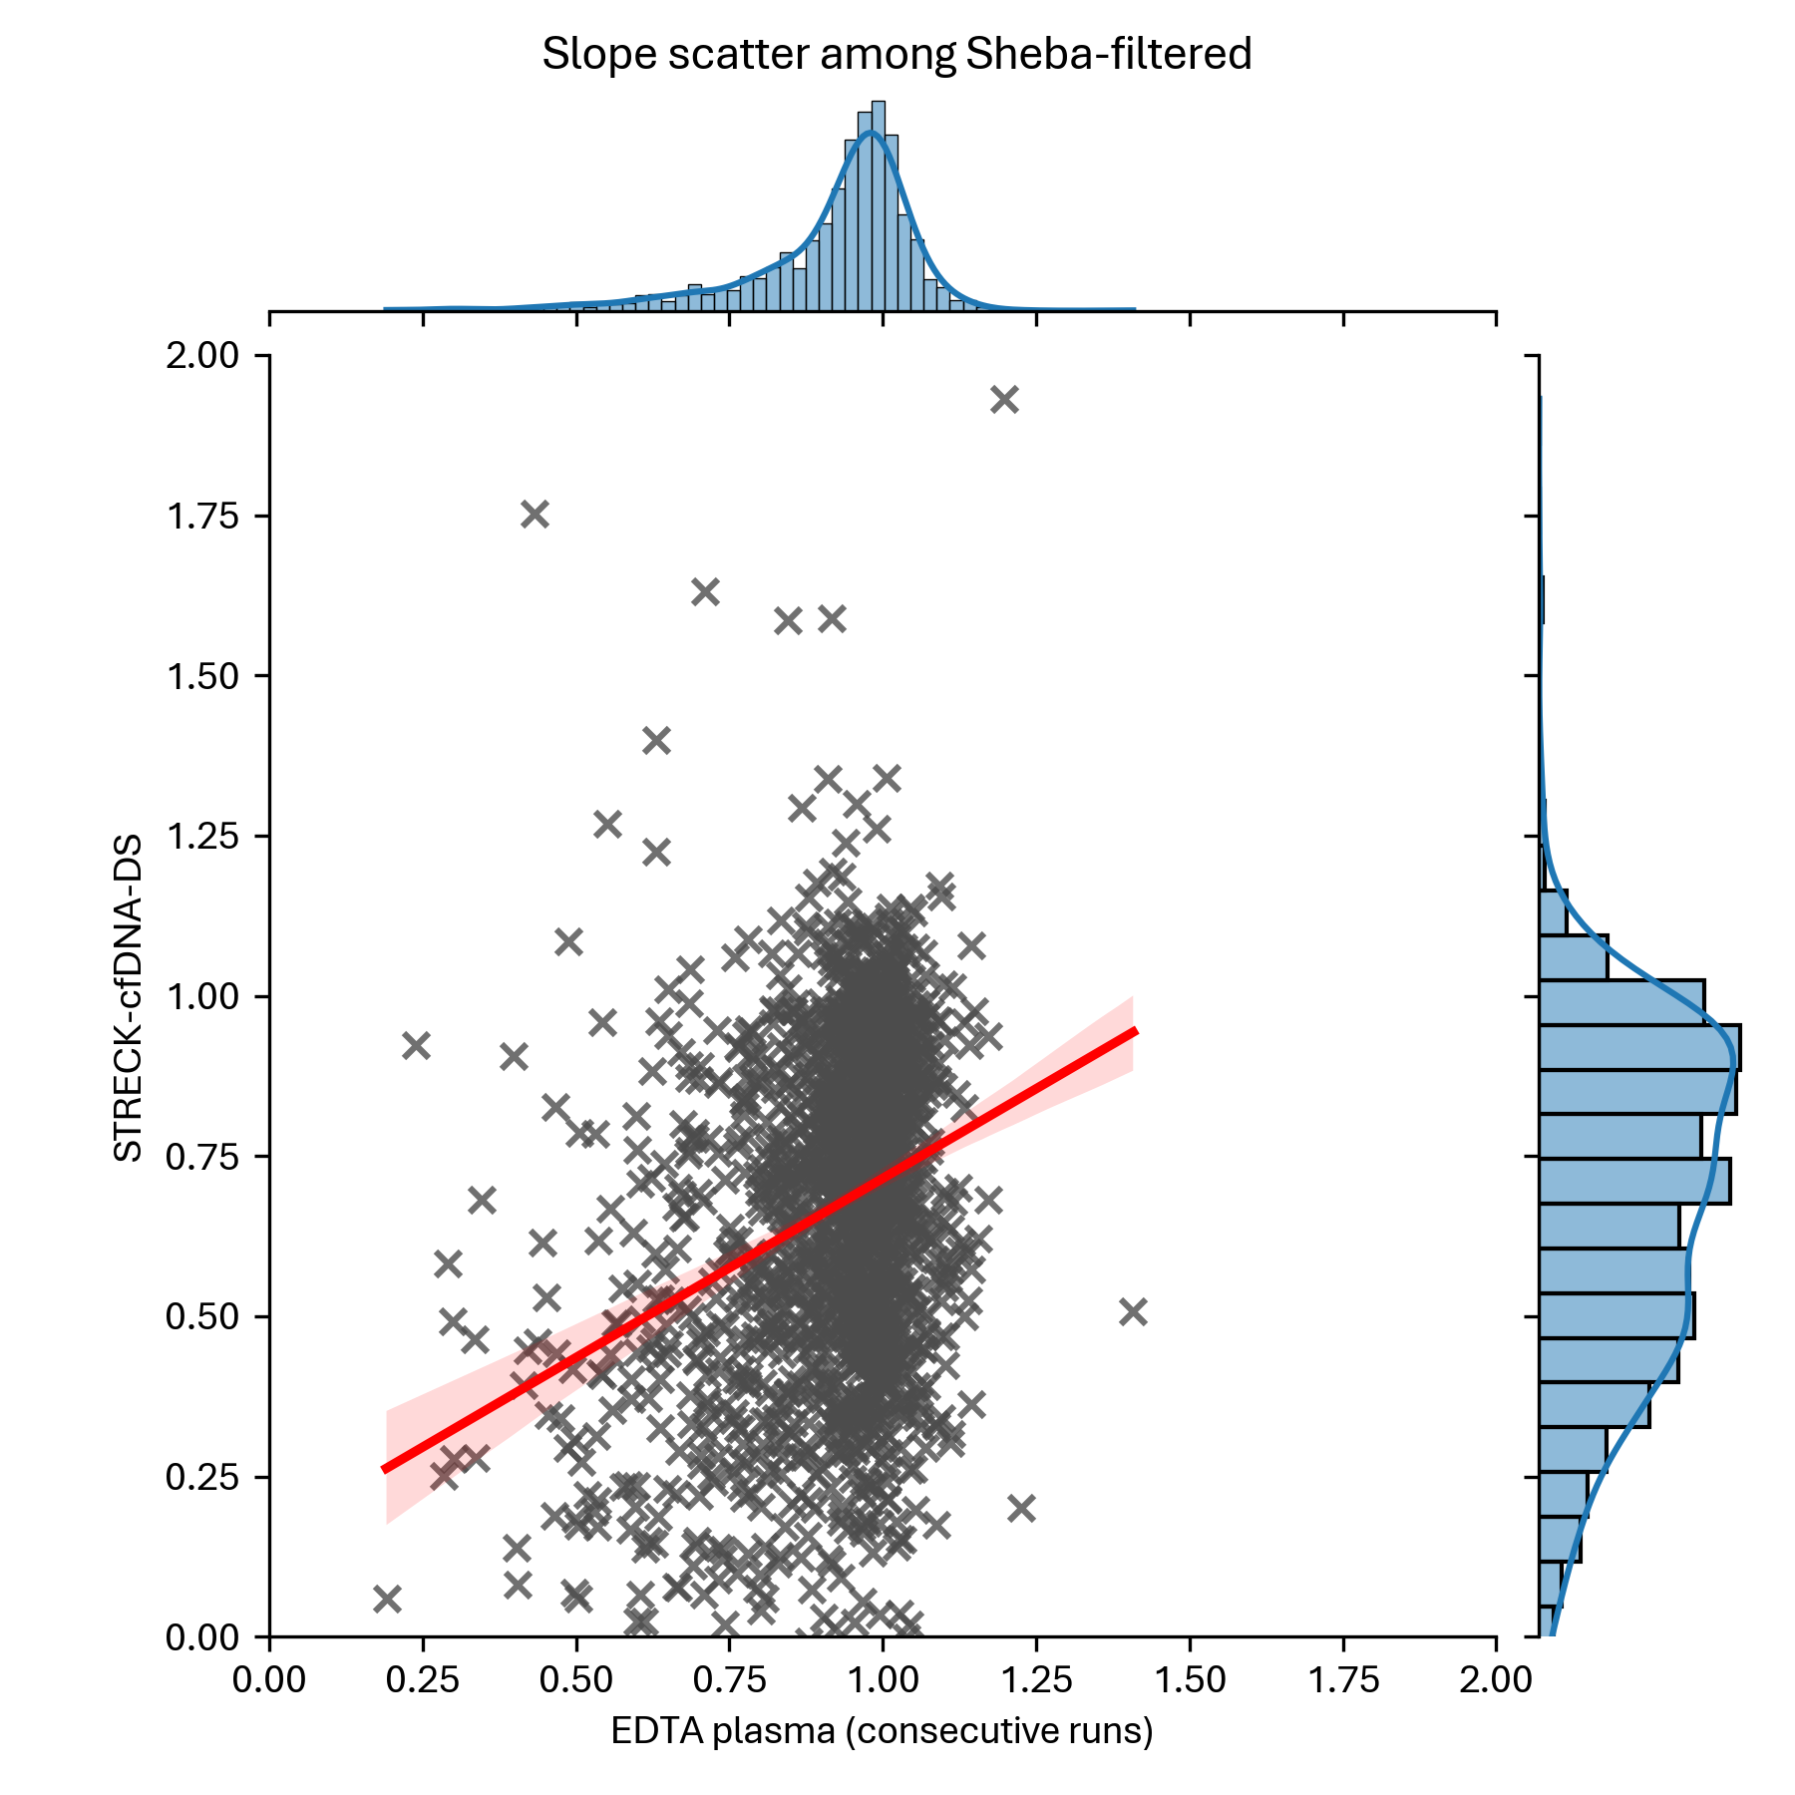
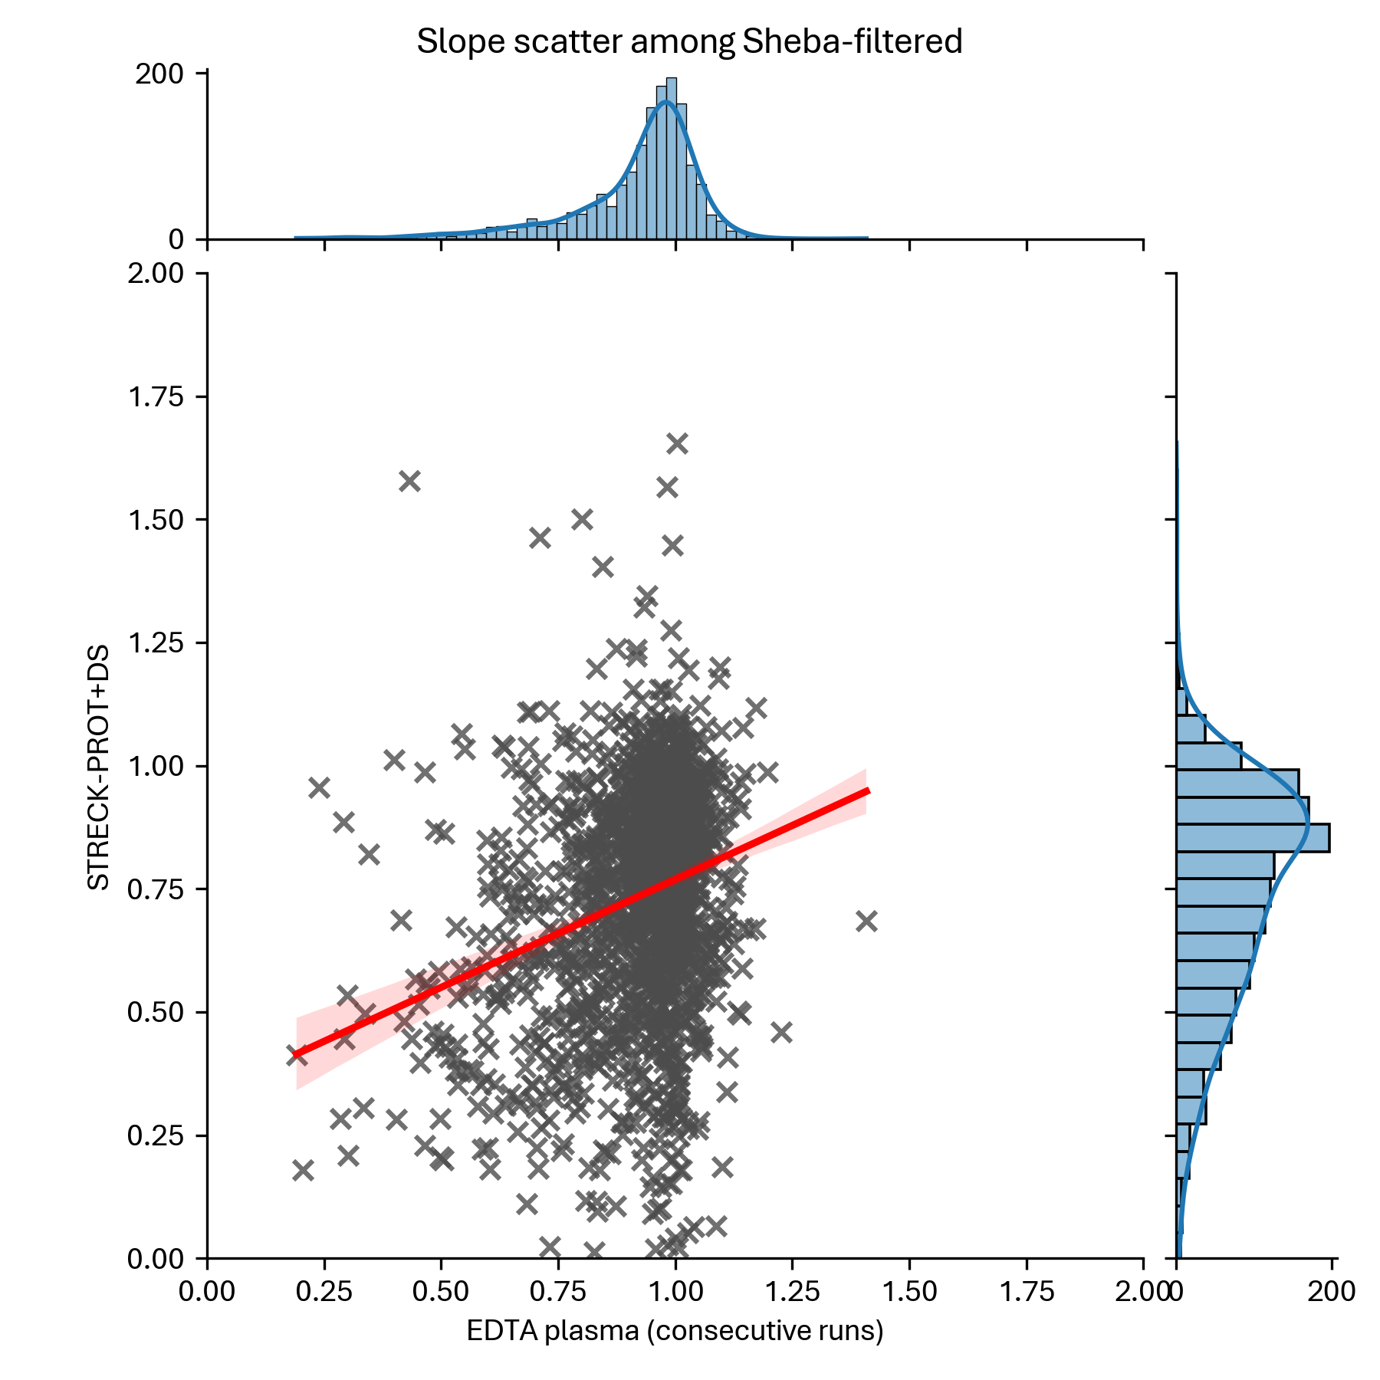
Slope – Streck Prot+ or cfDNA

Slide 34
Linear Regression: Intercept

Slide 35
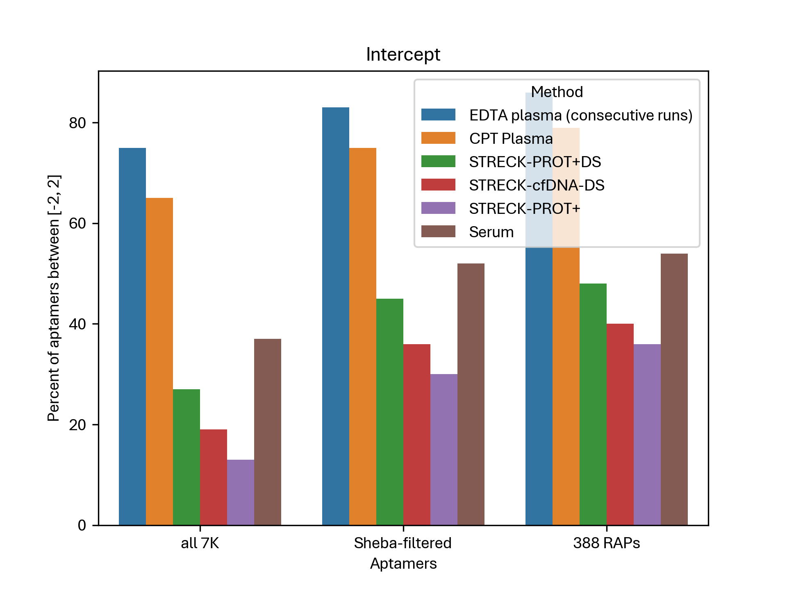
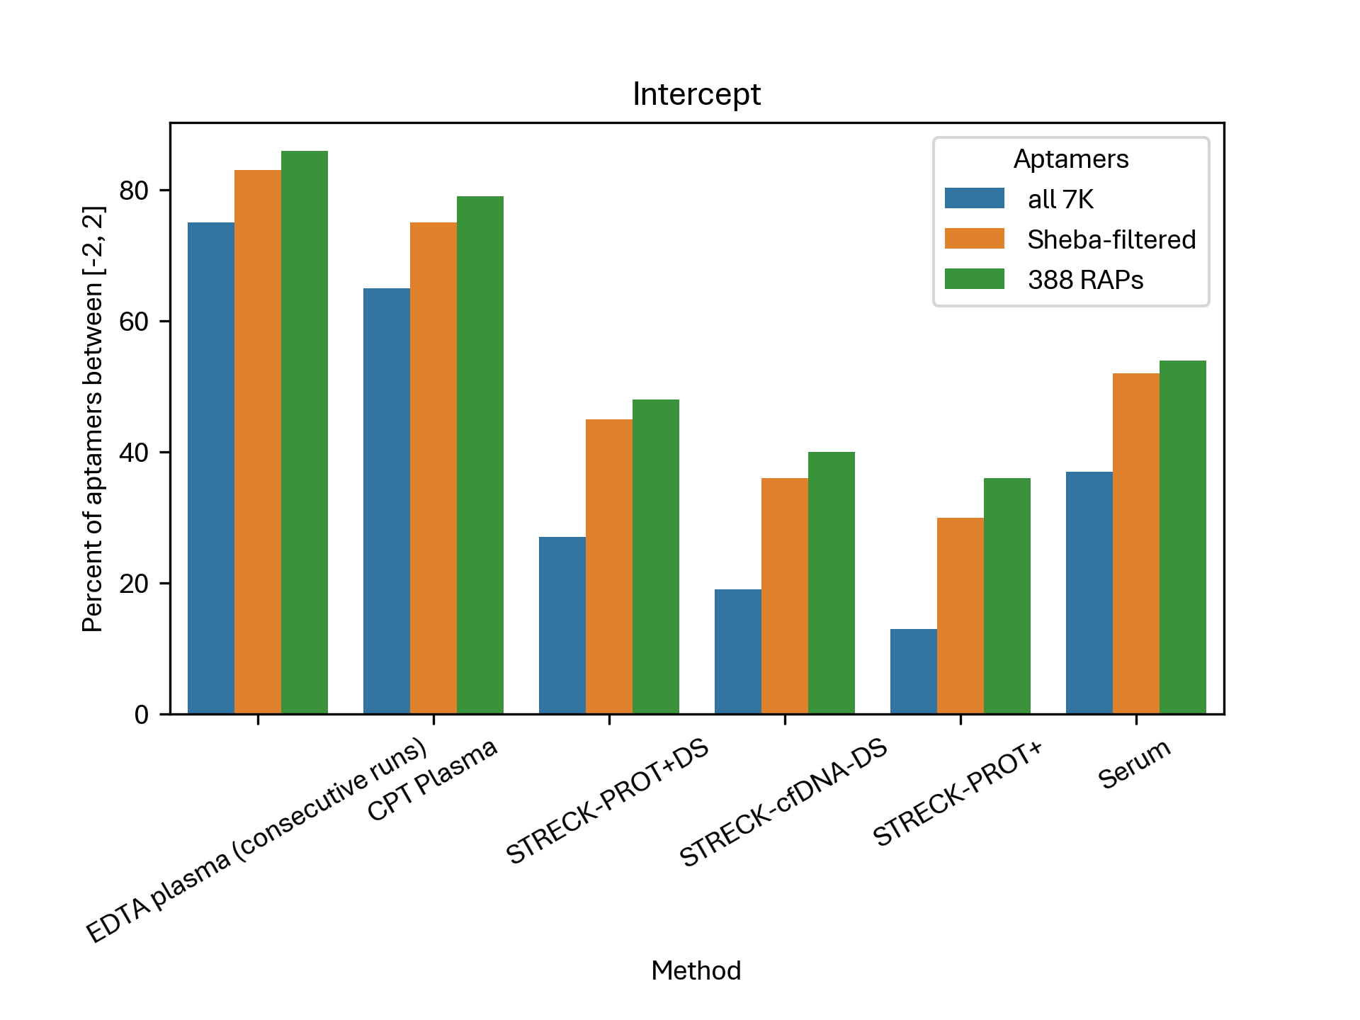
Linear Regression: Intercept – Summary

Slide 36
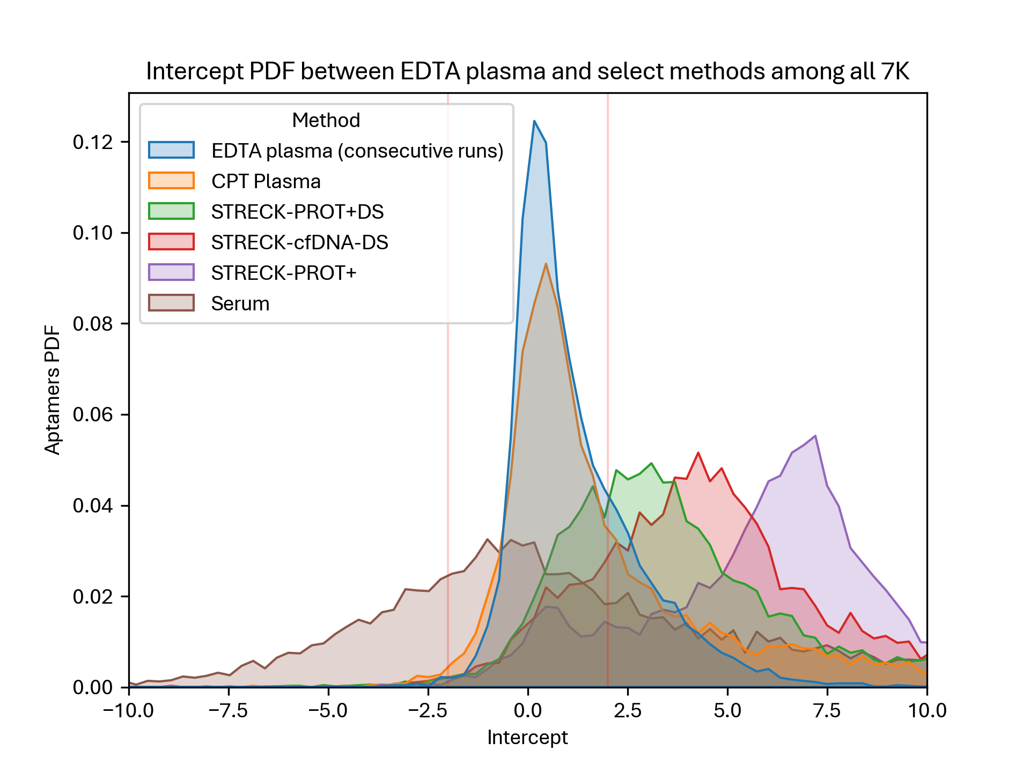
Linear Regression: Intercept – All 7K

Slide 37
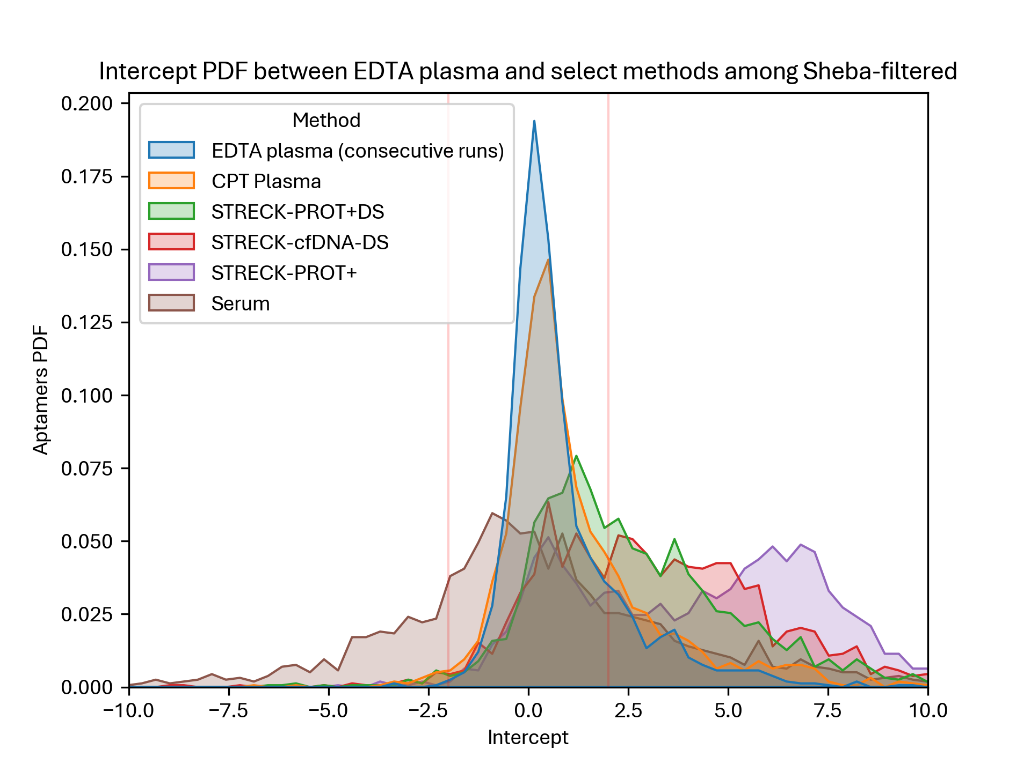
Linear Regression: Intercept – Sheba

Slide 38
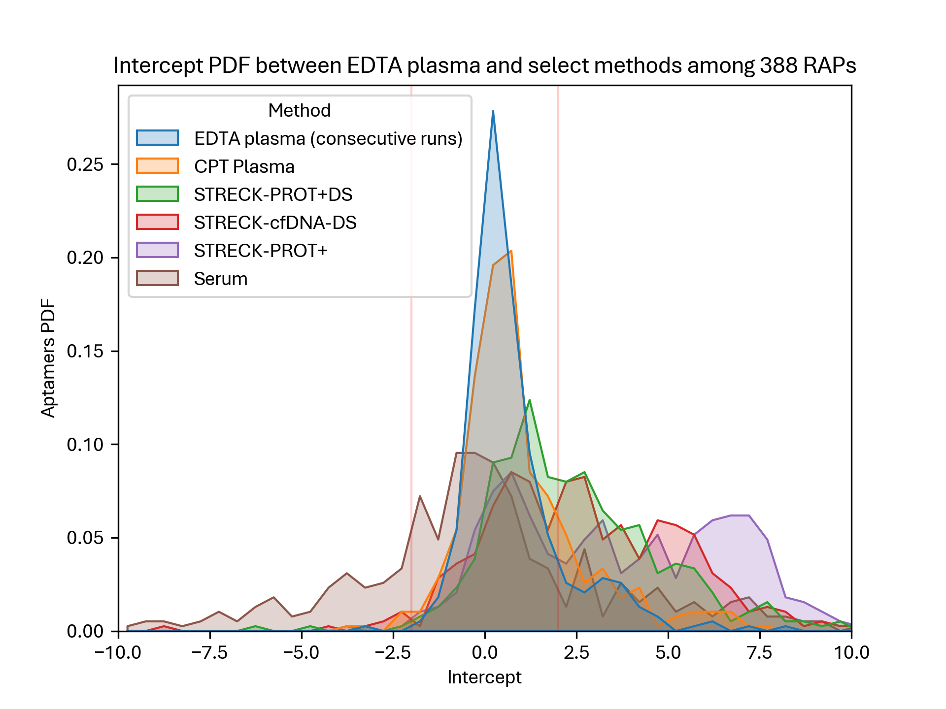
Linear Regression: Intercept – RAPs

Slide 39
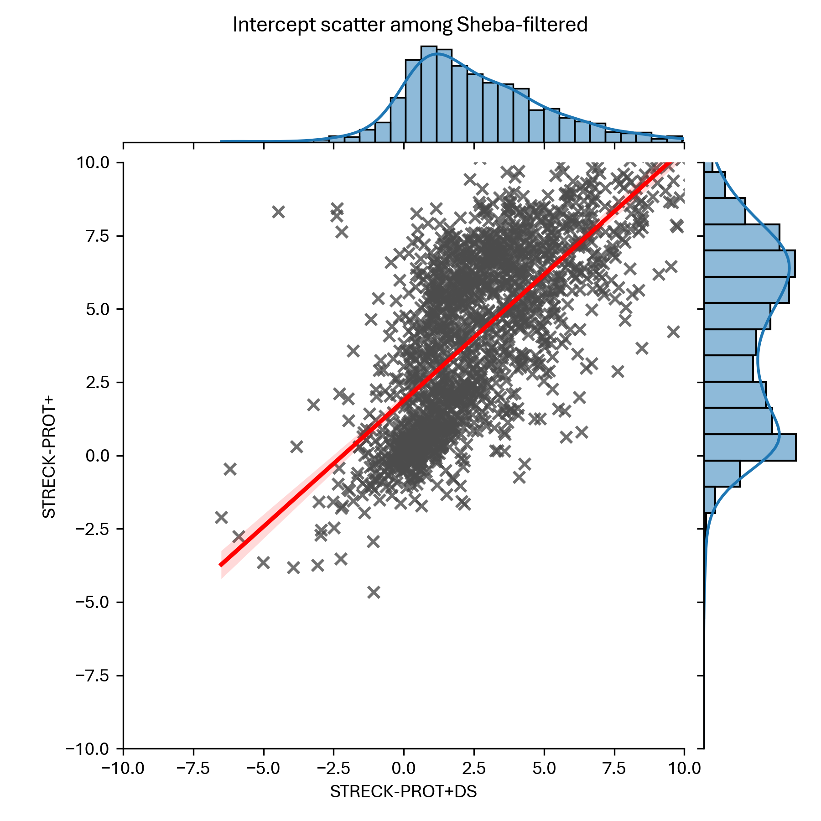
Intercept – With/Without DS

Slide 40
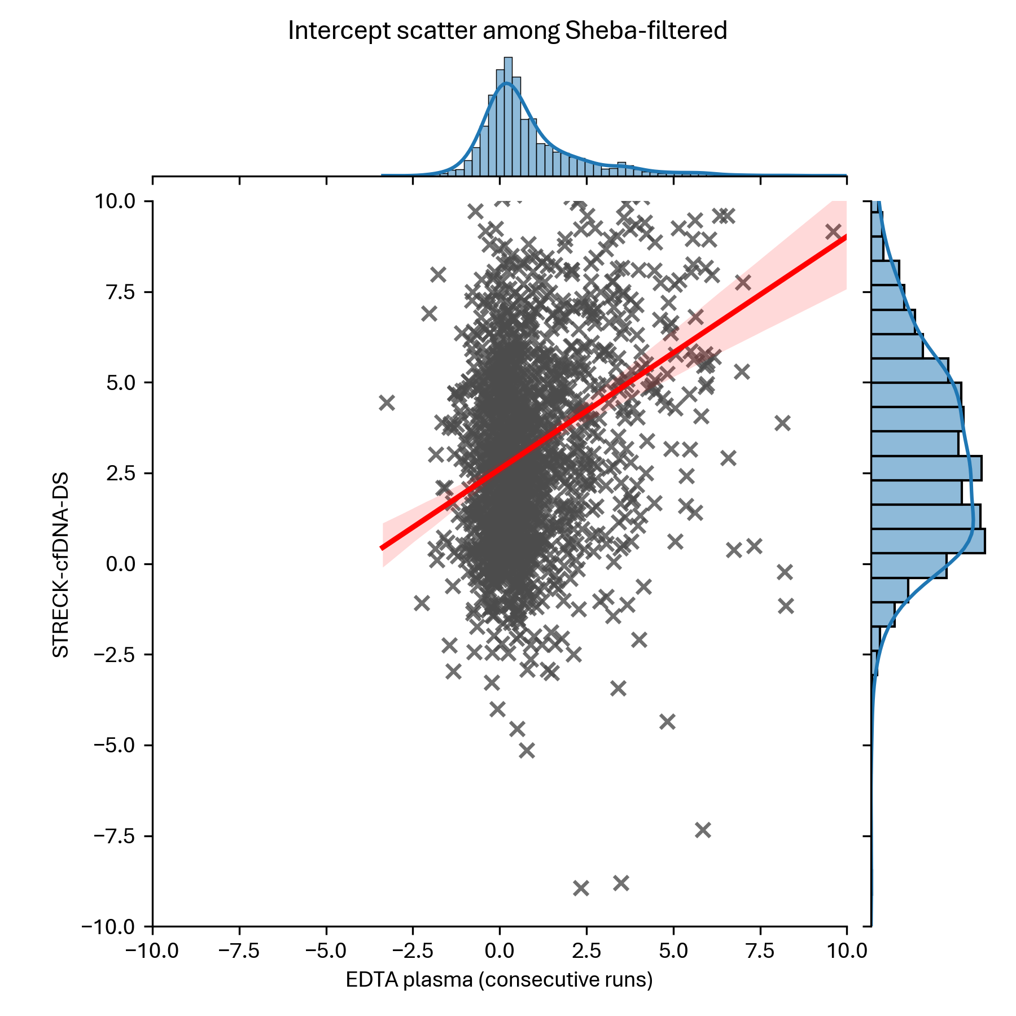
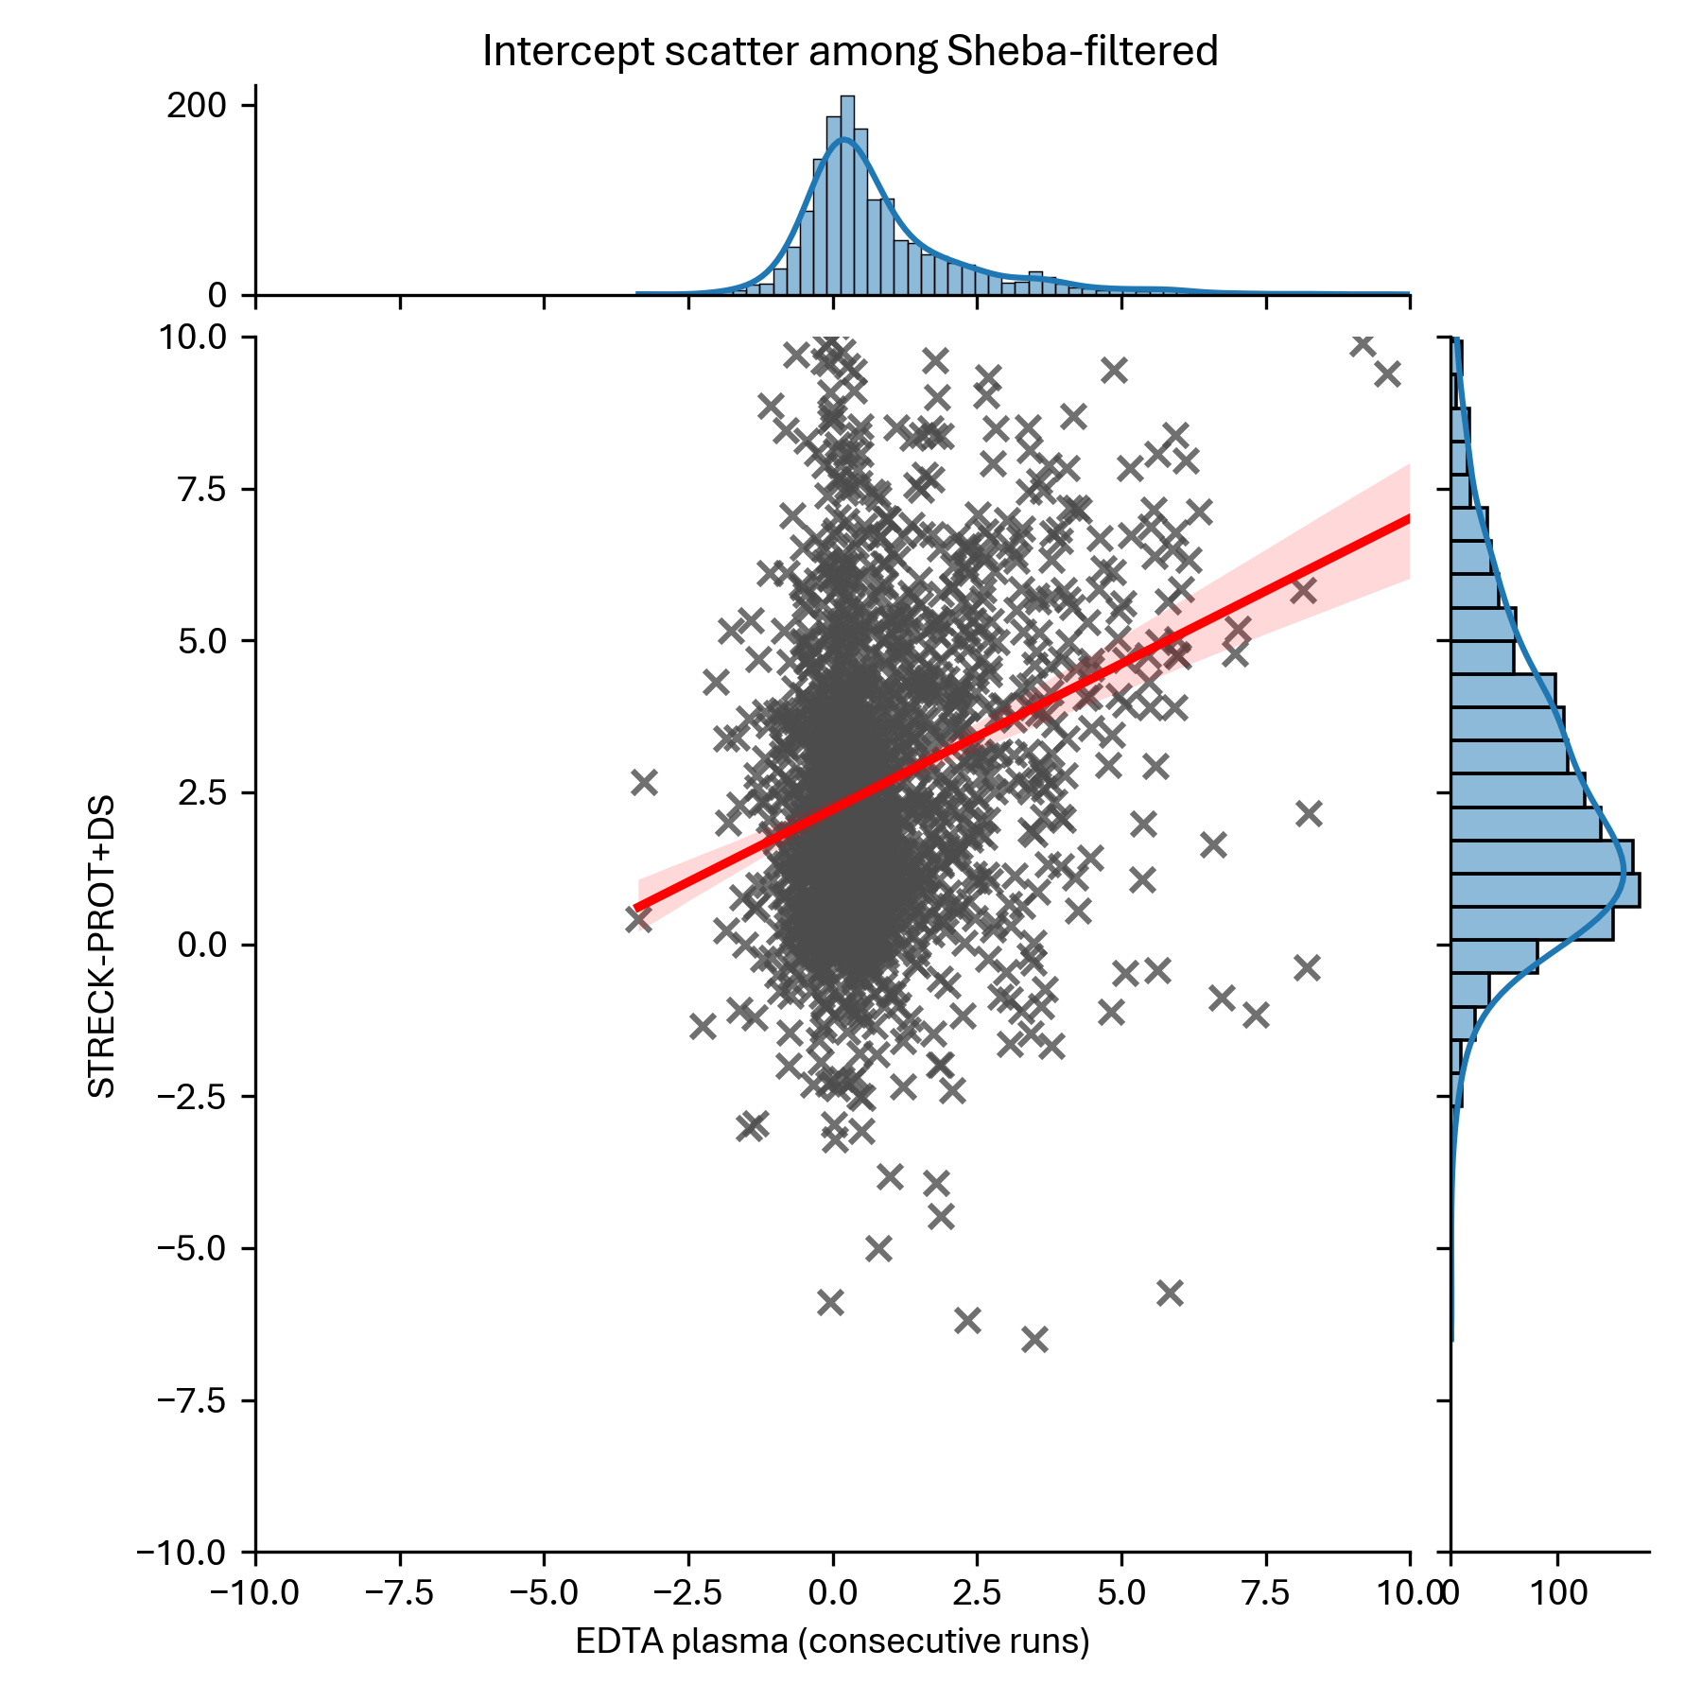
Intercept – Streck Prot+ or cfDNA

Slide 41
Normalization

Slide 42
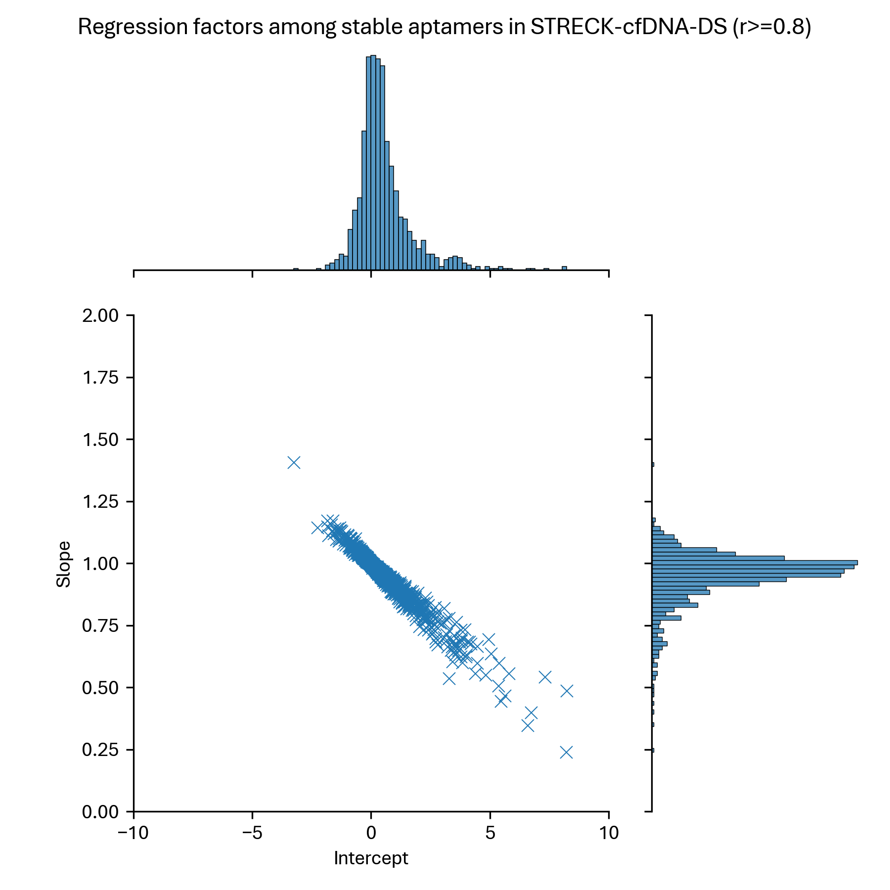
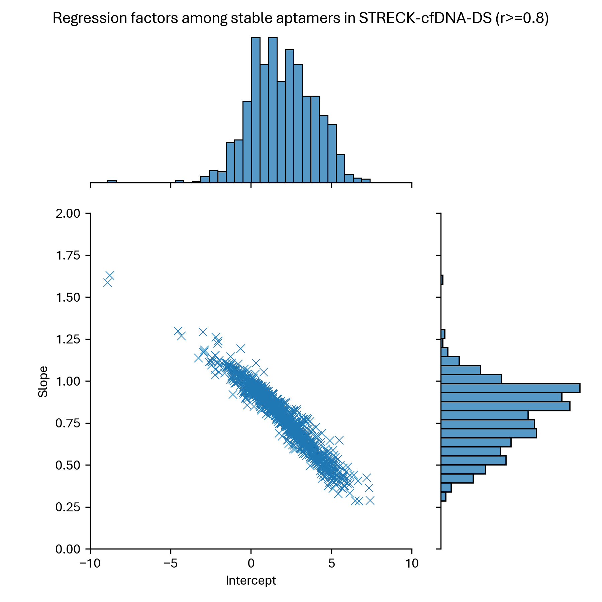
Consecutive EDTA vs Streck cfDNA
1,070 aptamers from Sheba filter, with Pearson’s r>=0.8

Slide 43

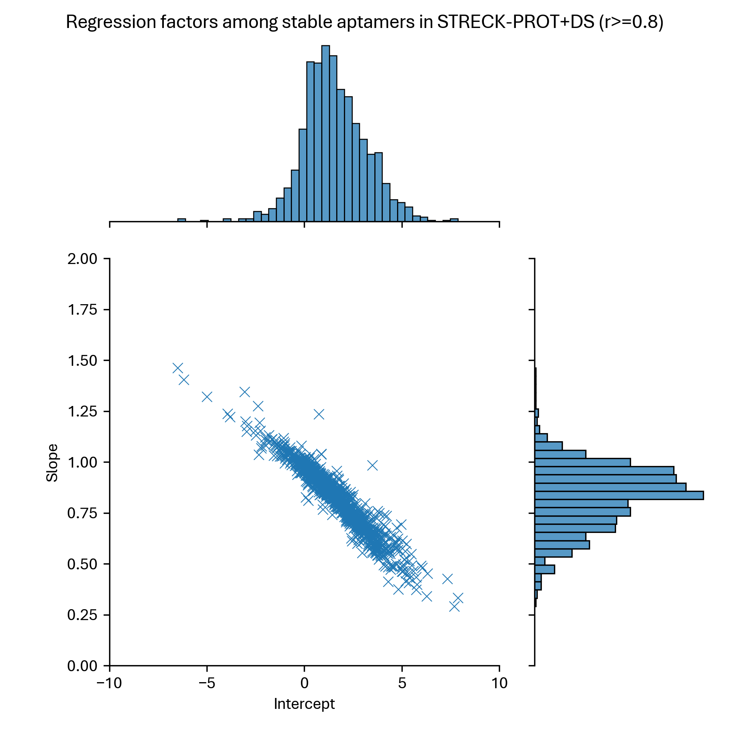
Consecutive EDTA vs Streck Prot+DS
1,083 aptamers from Sheba filter, with Pearson’s r>=0.8

Slide 44
Highlights for investors

Slide 45
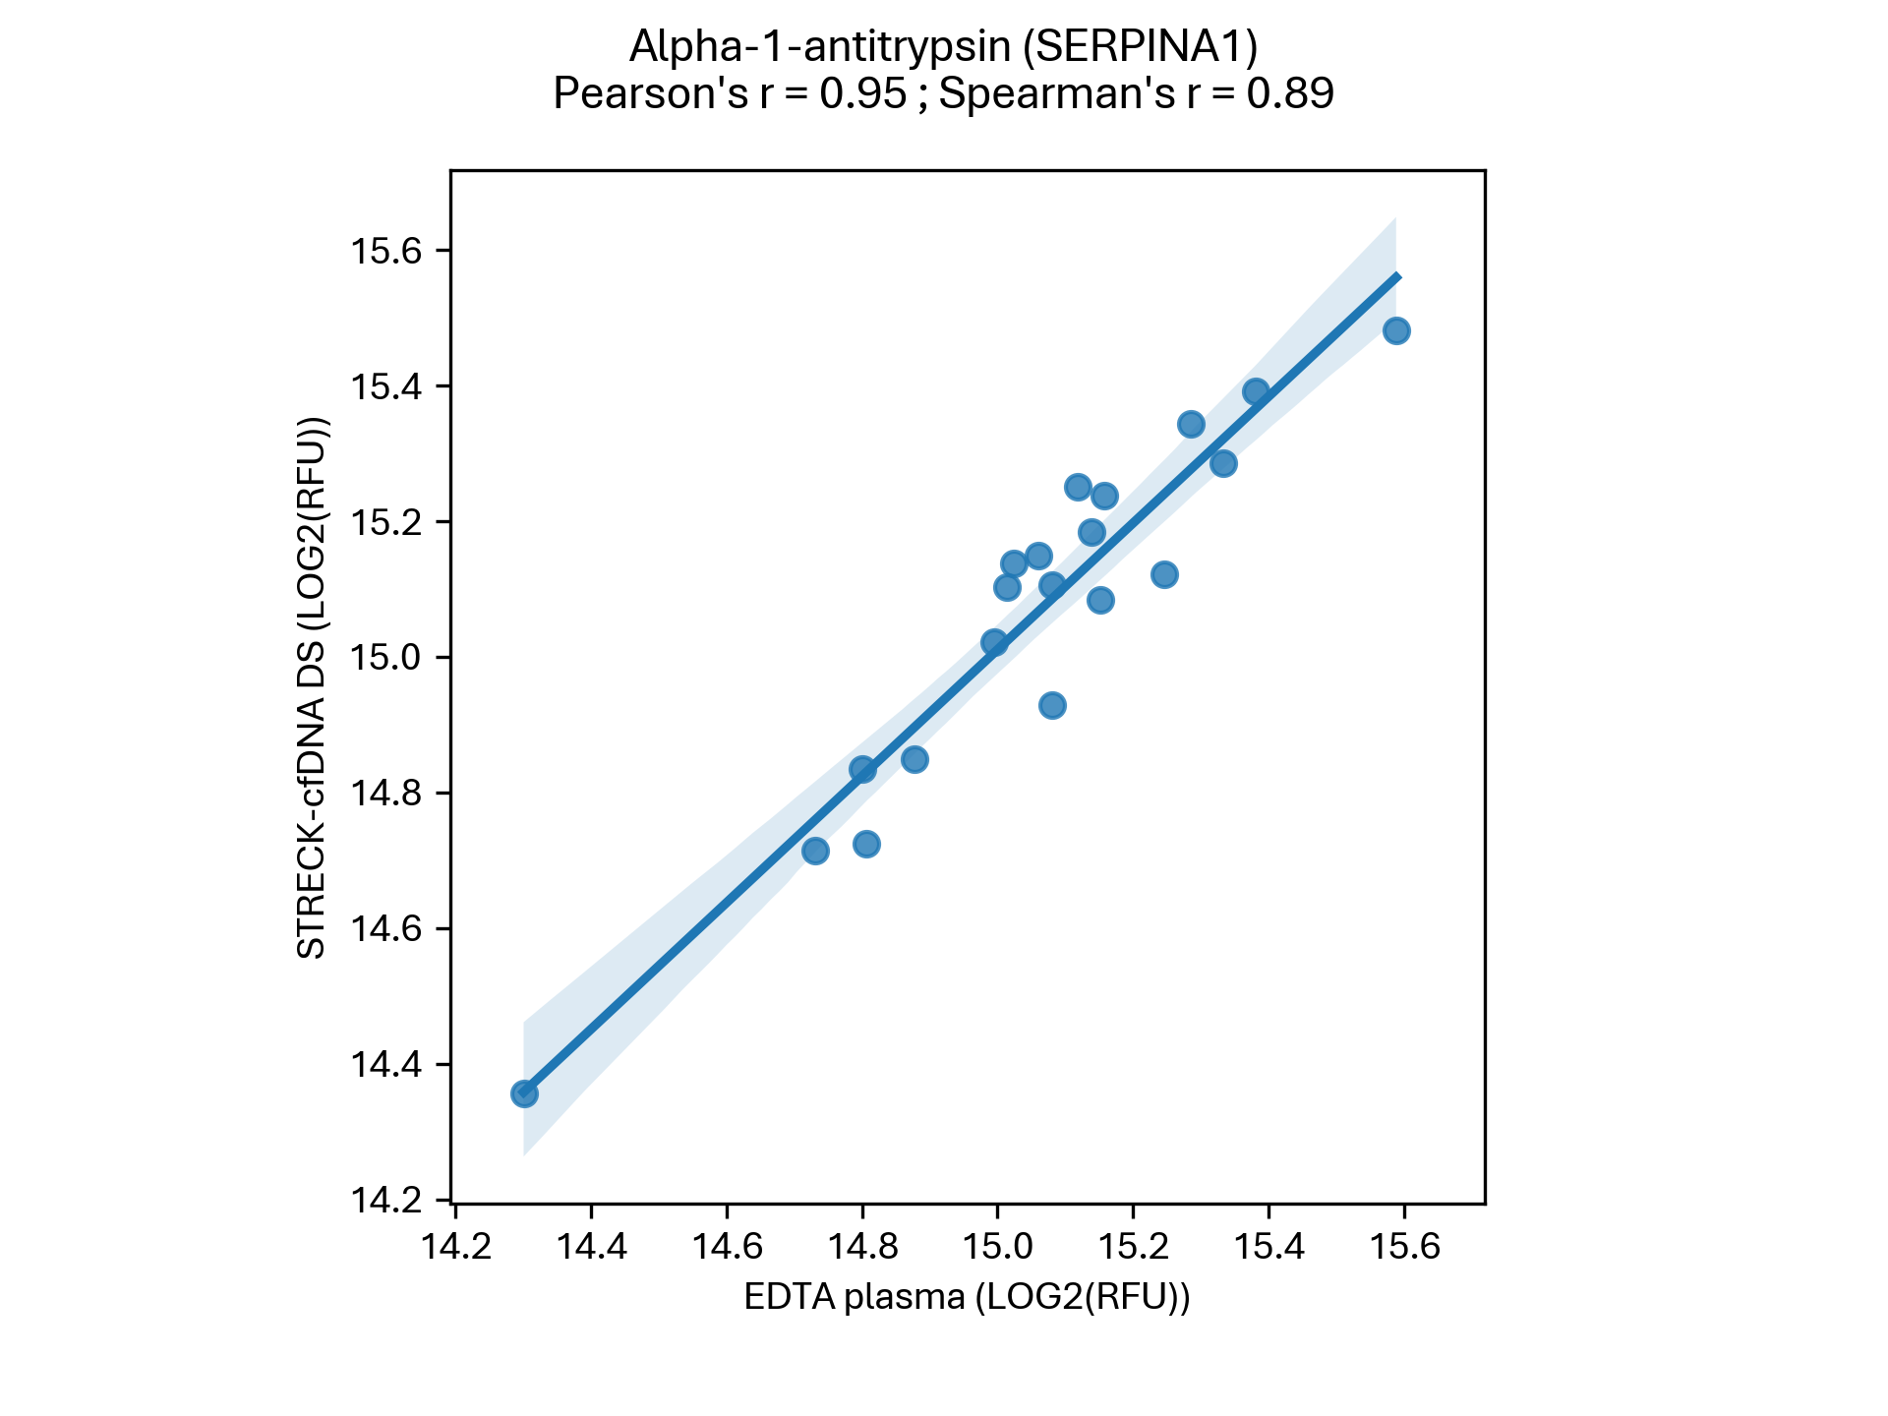
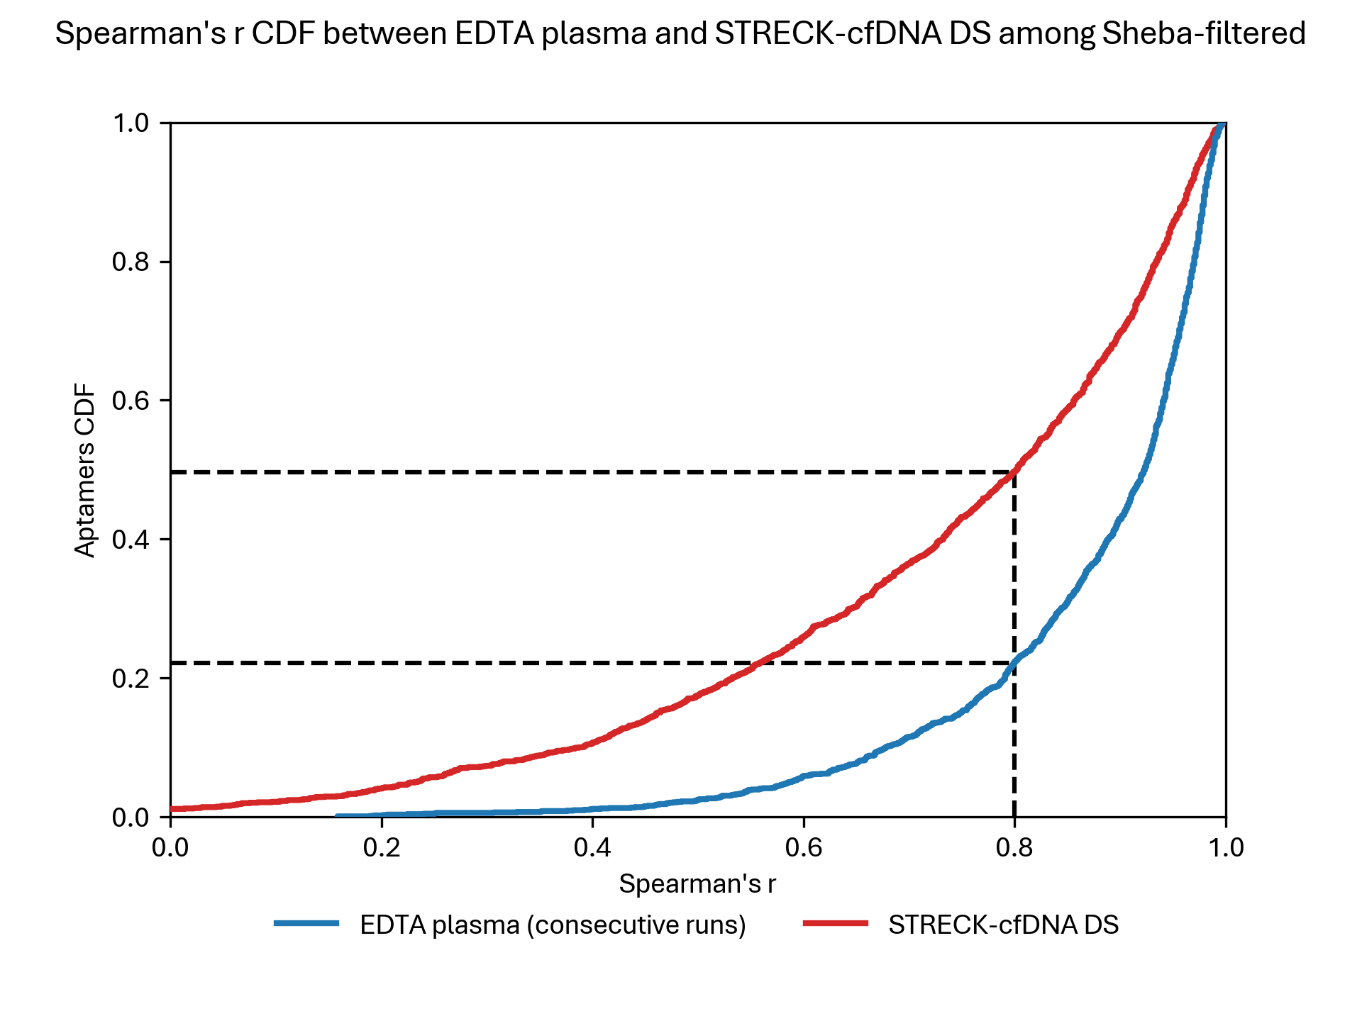



Streck cfDNA compared with EDTA consecutive runs

Slide 50
Pearson correlation – with/without DS

Slide 51
Pearson correlation – with/without DS

Slide 52
Conclusions

